Slide 1
Asking Questions
Simple Present vs Simple Past

Slide 2
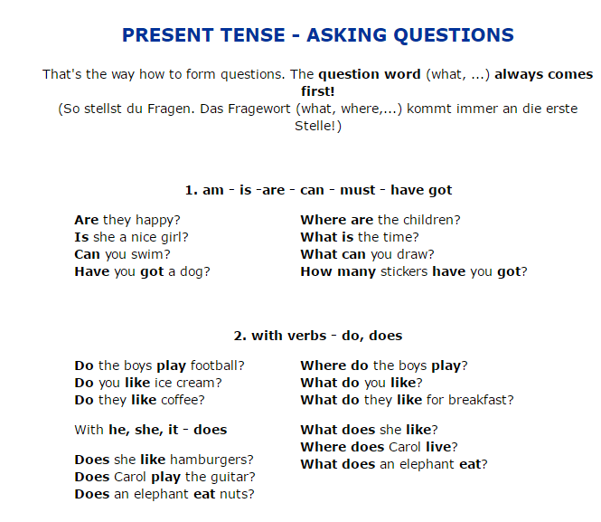

Slide 3
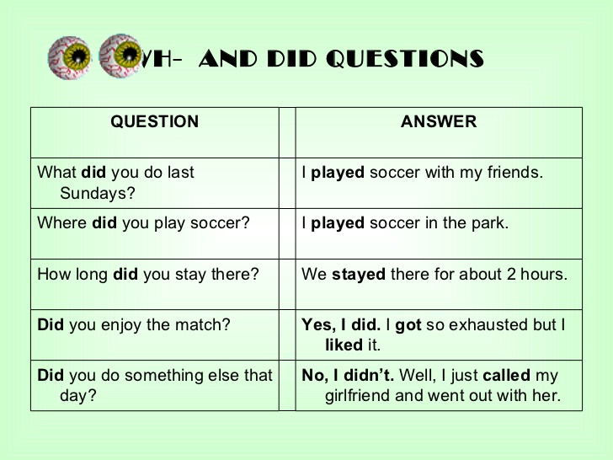

Slide 4
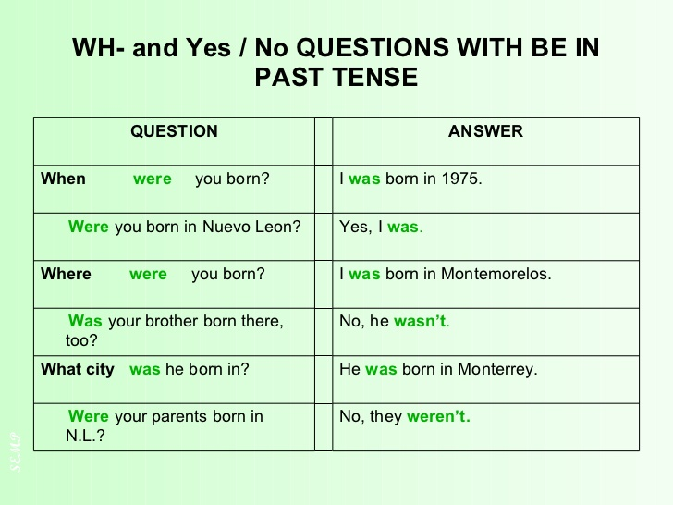

Slide 5
Exercises
Did you enjoy the film last night?
Do you like scary movies?
Where did you go on vacation?
Do you know the muffin man?
What type of films do you like to watch?

