Slide 1
- CHARACTERIZATION –

Slide 2
THINK ABOUT IT
What is the FIRST thing you notice about someone you meet for the very first time ?

Slide 3
PHYSICAL ATTRIBUTES
The way they dress
The way they smell
The way they speak
The way they look overall
The first things we notice about someone are these above attributes. Do you agree or disagree ? Is this considered to be judgmental ?

Slide 4
BODY LANGUAGE
Body Language: - non-verbal communication - person may reveal information through physical behavior.
- body posture, gestures, facial expressions, and eye movements.

Slide 5
WALK-IN ACTIVITY
How would a cocky person walk in to a room ?
How would a paranoid person walk in to a room ?
How would an excited person walk in to a room ?
How would a sad person walk in to a room ?
How would an angry person walk in to a room?
How would a lonerwalk in to a room ?
How would a confident person walk into a room ?

Slide 6
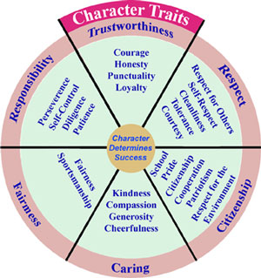
Character Traits
Major characters usually have unique traits or qualities that set them apart from other characters.
Friendly
Smart
Dishonest
Determined
Wise
Lazy
Generous

Slide 7
1 - How are these traits presented?
Authors present their characters to us in 2ways:
Indirectly – “showing” - reader must make a conclusion about something based on what they see. Mike always runs for the bus → he is not organized
Directly – “telling” - author describes the character Mike is disorganized →he is not organized

Slide 8
3 - DIRECT OR INDIRECT ?
Jane was a beautiful young girl. She had golden hair and blue eyes, which made her stand out from the rest. When Jane walked in the room, nobody could help but look at her stunning, gorgeous face. She commanded attention wherever she went due to her good looks.

Slide 9
DIRECT OR INDIRECT ?
Jim was an honest man. He never cheated anybody in his entire life. He respected everyone. You would not expect Linda to do what other women would normally do. After marrying a man she only knew for 3 months, Linda was left with a two month child and a divorce. This did not kill Linda's spirit though.

Slide 10
DIRECT OR INDIRECT ?
Will was very unlike any other businessman. He made sure that all his clients got what they had paid for. Sofia was a strong woman who lived her entire life on her own terms, without compromising and without ever being apologetic for anything.

Slide 11
DIRECT OR INDIRECT ?
Michael was very hungry so he decided to steal 5 pieces of candies at his local department store. When the clerk caught him, Michael ran away.
Stealing is a clear verb to describe Chanel. An example of this is when she said that she did not like Becky and stole her boyfriend from her.

Slide 12
DIRECT OR INDIRECT ?
While she was walking down the aisle, Lara, stepped on a candle, tripped on her dress, fell on a flower girl and finally kissed the floor.
Joe did not know how to work the computer as he always pressed CTRL-ALT-DEL to shut down his computer.

Slide 13
Question ???
Give 2 descriptions and why for each of the following characters:
a) Ian b) Julia c) Oswald

