Slide 1
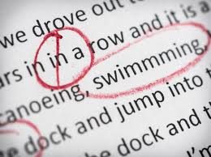
COUNT VS NON-COUNT AND COMMON ERRORS
FIRST ESSAY FEEDBACK ☺

Slide 2
Counts ? Non-Counts ?
COUNT NOUNS: things that you can count.
NON-COUNT: things that you cannot count.
1, 2, 3, 4, 5 . . . 100

Slide 3
CAN YOU COUNT ?
Count Nouns | Non-Count Nouns
pen table car idea answer student exam shoe | education intelligence clothing soap air homework cheese grass literature

Slide 4
BASIC EXAMPLES OF COUNT NOUNS
1 Pen = 5 _____
1 Man = 2 _____
1 Person = 4 ______
1 Exam = 3 _______
1 Shoe = 10 _______
1 Mouse = 8 _______
1 Class = 2 ________
1 Fly = 3 __________

Slide 5
COUNT OR NON-COUNT ?
SMILE
APPLE
RAINSTORM
FOOD
PAPER
WEATHER
HAPPINESS
SONG
MUSIC
RESEARCH

Slide 6
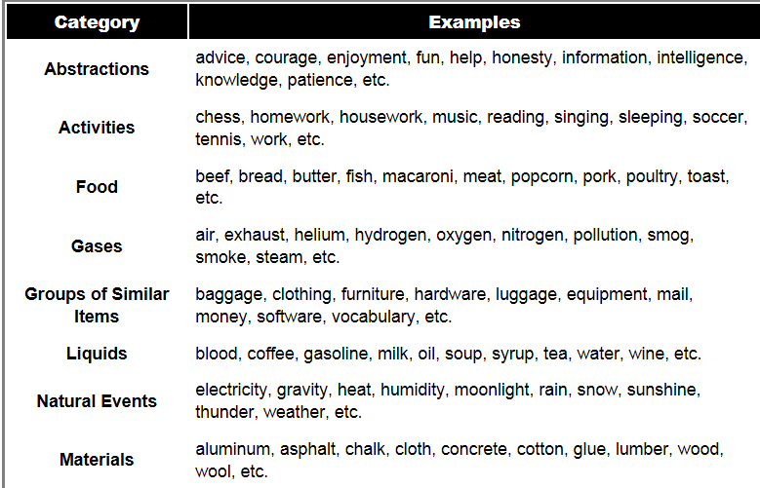

Slide 7
SINGULAR VS PLURAL
For nouns ending in f or fe, change f to v and add es.
wolf – wolves
wife – wives
leaf – leaves
life – lives
Some nouns have different plural forms. child – children
woman – women
man – men
person - people
mouse – mice
goose – geese
For the plural form of most nouns, add s. bottle – bottles
cup – cups
pencil – pencils
desk – desks
sticker – stickers
window – windows
For nouns that end in ch, x, s, or s sounds, add es. box – boxes
watch – watches
moss – mosses
bus – buses

Slide 8
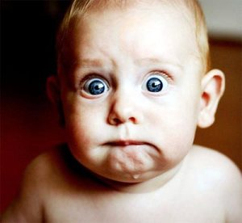
COMMON ERRORS FOUND 1) SPELLING ERRORS 2) VERB TENSE CHOICE 3) HOMOPHONE ERROR

Slide 9
ESSAY STRUCTURE INTRO 1) HOOK (DID YOU KNOW…IMAGINE) 2) DEFINITION OF TOPIC 3) THESIS (POSITION AND ARGUMENTS) BODY 1) TOPIC SENTENCE (FIRSTLY…) 2) EXPLANATIONS (EXPLAIN TWO ARGUMENTS) 3) CLOSING SENTENCE CONCLUSION 1) RESTATE THESIS STATEMENT 2) OUVERTURE (ASK A NEW QUESTION)

Slide 10
1) SPELLING ERRORS
WHIT → WITH
CAREFULL/BEAUTIFULL → CAREFUL, BEAUTIFUL
THE ONLY WORD THAT TAKES 2 `L` IS THE WORD FULLY (PLEIN)
COMMING → COMING
CHOICE: CHOIX CHOOSE: CHOISIR CHOSE: CHOISI

Slide 11
DEAD: MORT (ADJECTIF)
DEATH: MORT (NOM COMMUN) DIE: MOURIR (VERBE)
LIFE: LA VIE LIVE: HABITER

Slide 12
CONFUSION AND PRONUNCIATION ERRORS
A vs. AN A is used when the word begins with a consonant. AN is used when the word begins with a vowel. AN APPLE A DOG
HE`S vs. HIS
HE IS (IL EST)
HIS (SON – MASC.SING)

Slide 13
CONTINUED
HAIR VS AIR HAIR (CHEVEUX) AIR (L`AIR)
ANGRY VS HUNGRY ANGRY (FÂCHÉ) HUNGRY (FAIM)
GONNA VS GOING TO GONNA (IM LANGUAGE – FB TALK) GOING TO (FORMAL)

Slide 14
A LOT OF → MANY
BY EXAMPLE (par exemple) --» FOR EXAMPLE,
NIHGT, WAHT, WIHT, PERSUE, WICH/WITCH (sorcière) NIGHT, WHAT, WITH, PURSUE, WHICH (lequel)
THE STORE WAS LOSING PROFIT. HE WAS AFFECTED BY THE AMOUNT OF ILLEGAL DOWNLOADS. HE = IT; A STORE IS NOT A HUMAN BEING.

Slide 15
EVERYONE/EVERYBODY VS. ANYONE/ANYBODY TOUT LE MONDE N`IMPORTE QUI
ANYTHING VS NOTHING N`IMPORTE QUOI RIEN
THE WORK OF THE AUTHOR --» AUTHOR`S WORK THE HOUSE OF HIS MOTHER --» HIS MOTHER`S HOUSE THE LIFE OF A WORKER --» WORKER`S LIFE
REMEMBER NOT TO USE EXCLAMATION POINTS !!! YOU ARE NOT YELLING AT THE READER BUT CONVINCING THEM.

Slide 16
CONTINUED (POSSESIF HIS/HER)
MARY`S MOTHER → HER MOTHER
JACK`S CHAIR → HIS CHAIR
SARAH`S BOYFRIEND → HER BOYFRIEND
MIKE`S WIFE → HIS WIFE

Slide 17
2) VERB TENSE
WHEN YOU WRITE ABOUT SOMETHING THAT ALREADY HAPPENED, LIKE A STORY YOU READ OR A MOVIE YOU SAW: PAST
IF IT IS SOMETHING THAT YOU DO EVERY DAY, IT IS HABITUAL OR IS TAKING PLACE NOW: PRESENT
WHEN YOU ARE ABOUT TO DO SOMETHING OR YOU WILL DO IT IN THE FUTURE: FUTURE
I WILL ______

Slide 18
24 COMMONLY USED VERBS IN ESSAYS
13. look
14. want
15. give
16. use
17. find
18. tell
19. ask
20. work
21. seem
22. feel
23. try
24. leave
be
have
do
say
get
make
go
know
take
see
come
think

Slide 19
3) HOMOPHONES
TO: À TWO: 2, DEUX TOO: AUSSI
THEIR: LEUR KNOW: SAVOIR THERE: LÀ NO: NON THEY`RE: ILS SONT
WHICH: LEQUEL BEE: ABEILLE WITCH: SORCIÈRE BE: ÊTRE
I: JE EYE: L`ŒIL

Slide 20
HOW MANY MISTAKES CAN YOU FIND? CORRECT THIS !
Kathy were running down the street. She had a lot of feelings of stress. She stoped running to attach her chose. She herd a noise. She turned her head and looked behind her and screamed. She saw a men with a big long knives. Kathy was so scary that she started to run fast. Finally, she got home and was saf. She take off her jacket, went upstairs and hugged her childs and wished them a godnite because she was contente too be safe.
Kathy were running down the street. She had a lot of feelings of stress. She stoped running to attach her chose. She herd a noise. She turned her head and looked behind her and screamed. She saw a men with a big long knives. Kathy was so scary that she started to run fast. Finally, she got home and was saf. She take off her jacket, went upstairs and hugged her childs and wished them a godnite because she was contente too be safe. (14)
Kathy was running down the street. She felt very stressed. She stopped running to tie her shoes. She heard a noise. She turned her head and looked behind her and screamed. She saw a man with a big long knife. Kathy was so scared that she started to run fast. Finally, she got home and was safe. She took off her jacket, went upstairs and hugged her children and wished them a goodnight because she was happy to be safe. (14)

