Slide 1
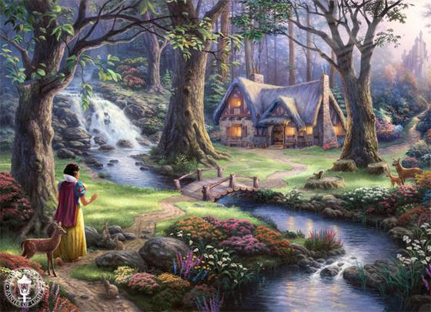
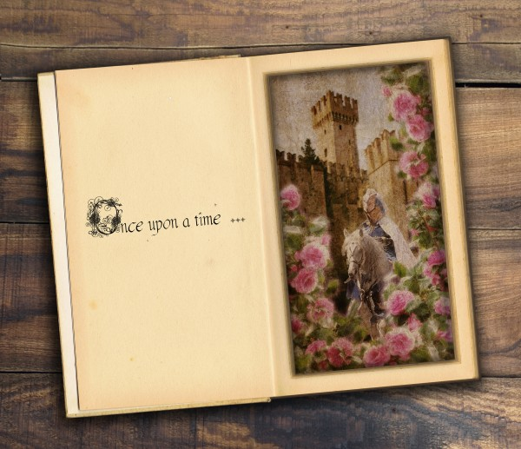
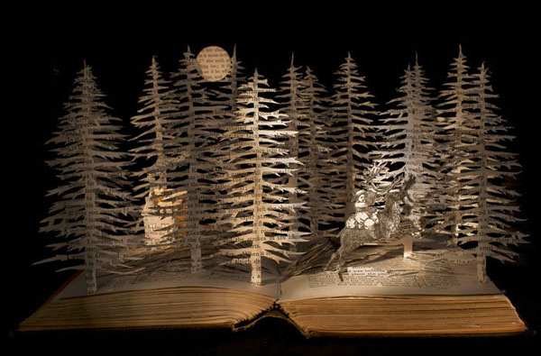
FAIRY TALES

Slide 2
Did You Know ? (in the real version of…)
Snow White: Snow White asks the dwarves to make iron shoes so that the evil stepmother can dance till she dies. Little Red Riding Hood: The Wolf eats her. Beauty and the Beast: Belle turns into a beast. Hansel & Gretel: The children are thrown into the forest by their parents because it is too expensive to raise them.

Slide 3
FAIRYTALE 101
WWW.KAHOOT.IT
GAMEPIN: 334048
Open your laptops and write this URL:

Slide 4
What is a Fairytale?
Fairytale (conte de fées): a story about magical and imaginary beings that contains an important message.
Most fairy tales have these common elements:

Slide 5
Elements
CONCEPT | MEANING
Special Beginning/Ending | Once upon a time...and they lived happily ever after.
Good Character(s) | Do you see a kind, innocent character? Is the good character clever? Is s/he helped by others?
Evil Character (s) | Is there an evil stepmother or evil creature? Are there bad people?
Royalty/Superiority | Is there a castle or a superior person?
Poverty/Inferiority | Do you see a poor working girl, a poor family, a poor boy?
Magic | Do you see magical things happening? Do you see talking animals/magical objects?
Loss of a Parent/Object | Character lost a parent or object. Father or Mother passed away.

Slide 6
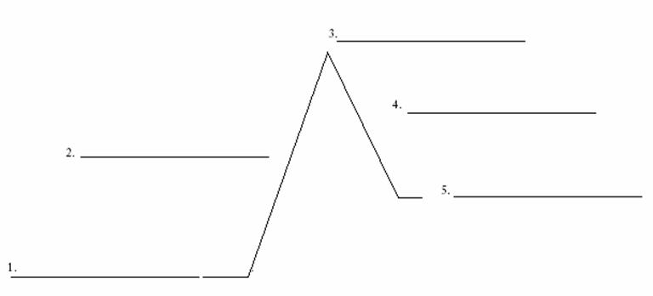
Common Fairytale Plot Structure
Climax: Big event takes place between good & evil.
Rising Action: Meet new characters (some are magical) Face obstacles
Falling Action: Everything goes back to normal.
Resolution: Character is happy, has new friends and lives a good life.
Exposition: History of main character Character is sad about their present life Character has lost a parent
Turning Point: Problem is presented Something magical happens

Slide 7
Fairy Tales
Little Red Riding Hood
Beauty and the Beast
Cinderella
Little Mermaid
Goldilocks and the Three Bears
Sleeping Beauty
The Three Little Pigs Jack and the Beanstalk Snow White and the Seven Dwarfs Aladdin

Slide 8
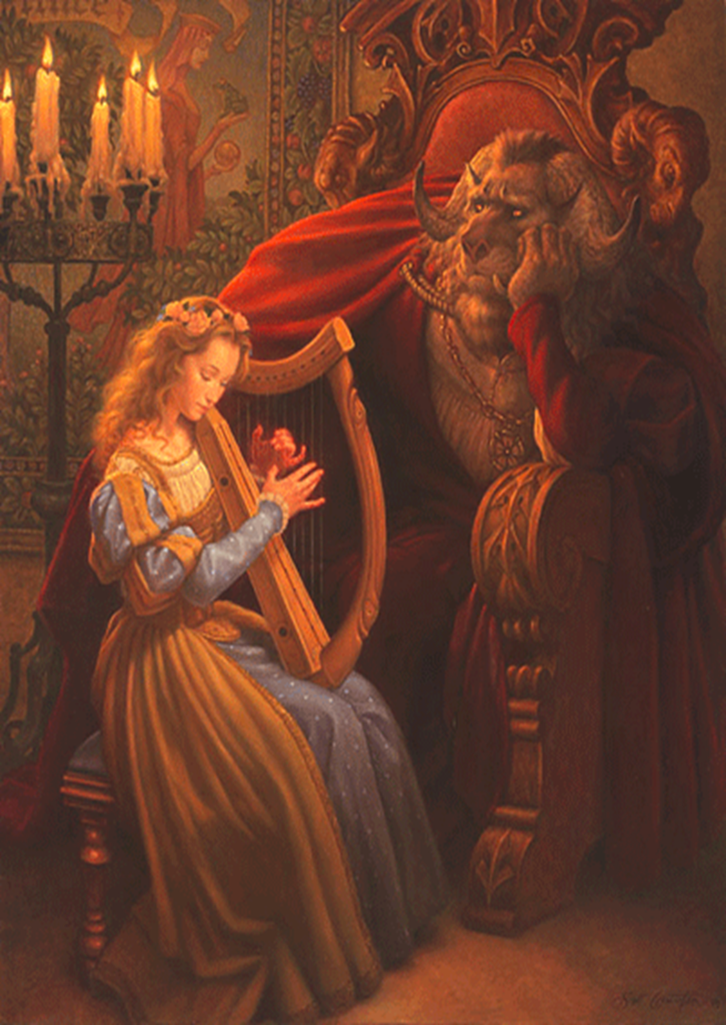
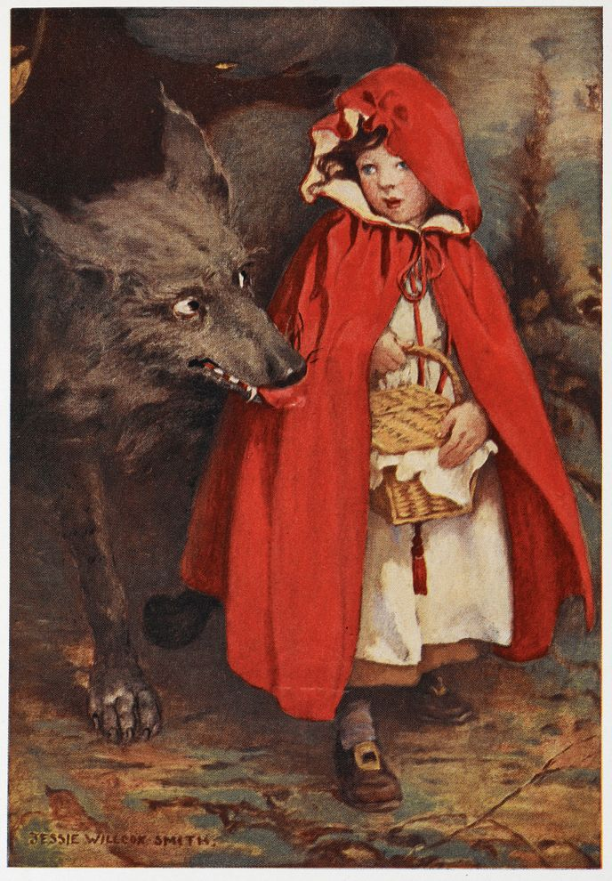

Slide 9
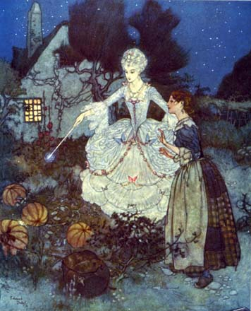

Slide 10
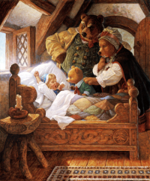
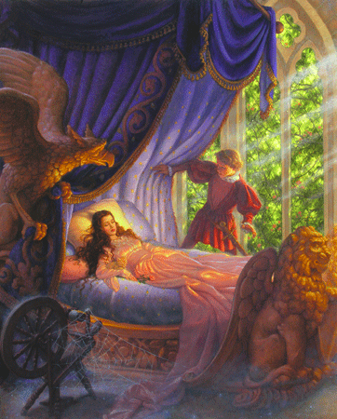

Slide 11
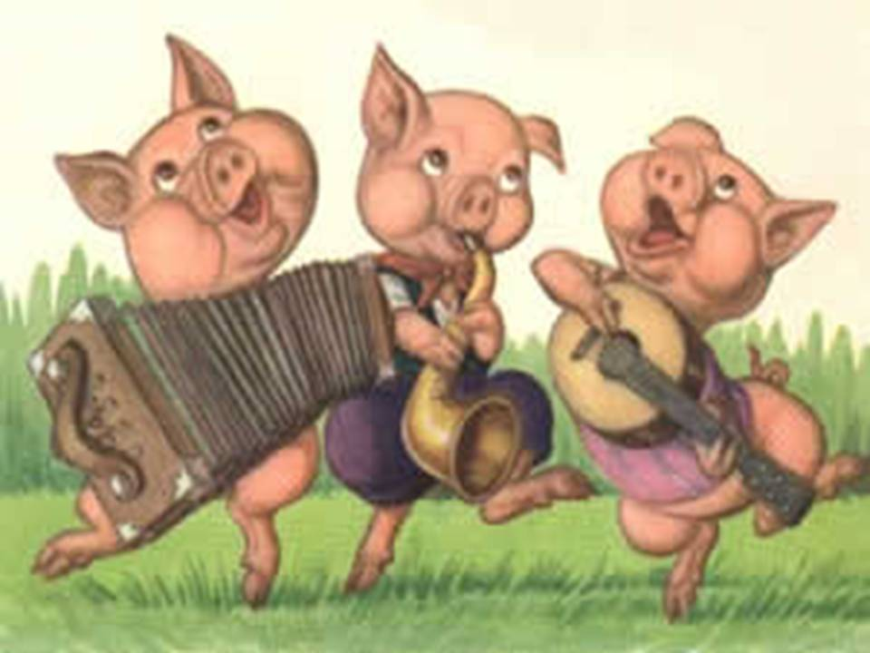

Slide 12
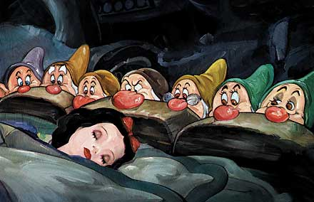
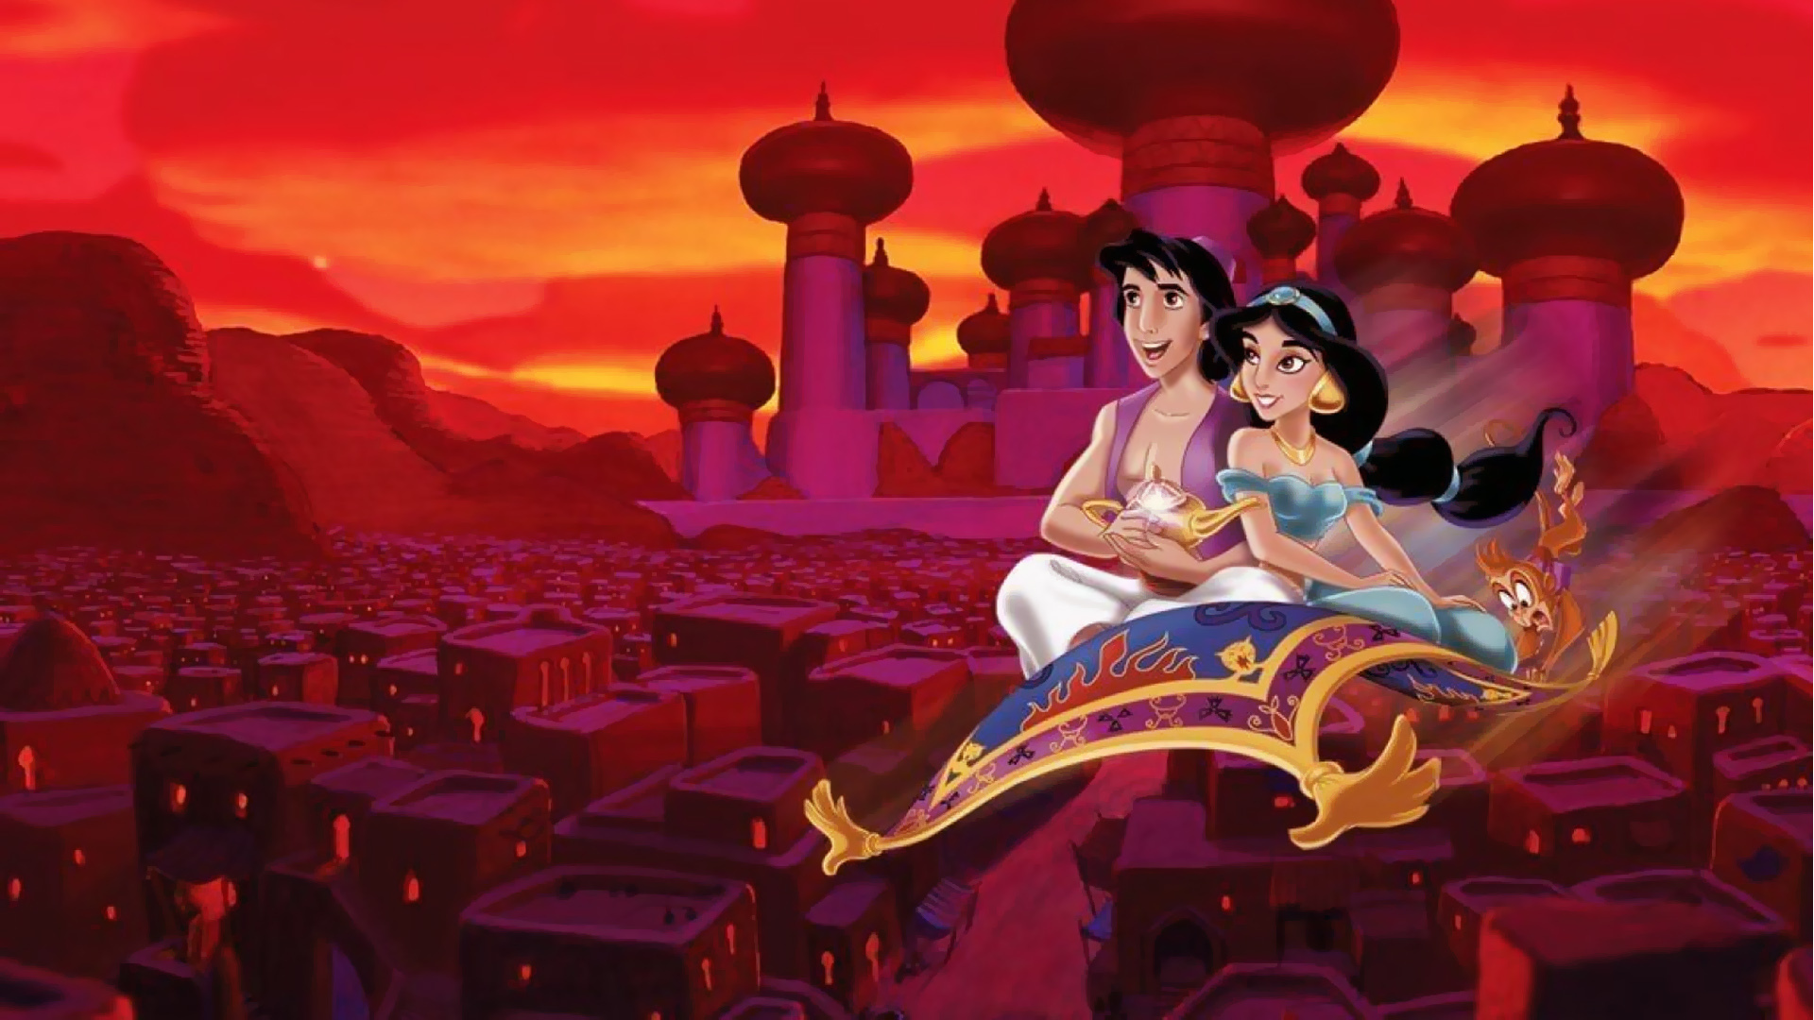

Slide 13
Activity
In pairs, choose ONE Fairy Tale and answer the question:
1) Is there a Special Beginning/Ending
2) Who are the Good Character(s)
3) Who are the Evil Character(s)
4) Who is associated to Royalty?
5) Who is associated to Poverty?
6) What is Magical?
7) Did the main character lose a Parent/Object?

Slide 14
WRITE THIS CHART… WITH THE FAIRYTALE
ELEMENT | Y OR N | WHAT/WHO?
1) Special Beginning/Ending
2) Good Character(s)
3) Evil Character(s)
4) Royalty/Superiority
5) Poverty/Inferiority
6) Magic
7) Loss of Parent or Object

