Slide 1
Flight account
C2 – A WAVE PROJECT

Slide 2
Choose ONE of the two options below. Write a chapter about how that character was feeling or thinking while on the plane to Thailand. Option 1: Chapter 1.5 Sam: Flying to Thailand for Christmas vacation ☺
Option 2: Chapter 11.5 Beth: Flying to Thailand to find her family ☹

Slide 3
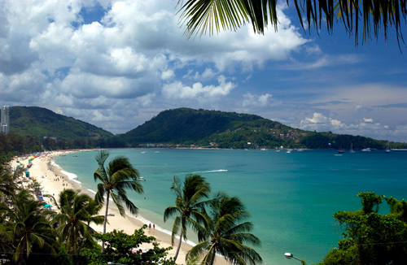
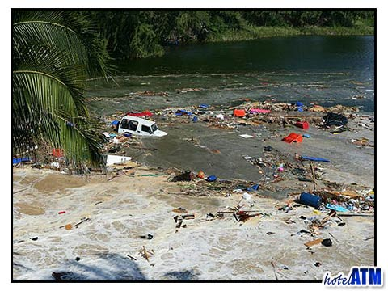

Slide 4
Your chapter must include and answer the following questions:
Motivation: Why are you going to Thailand? With whom are you going?
Emotions: How are you feeling while on the plane to Thailand?
Description: Describe Thailand when you finally arrive.
Expectations: What do you expect to find or do in Thailand?
Your text must be between minimum 180 to maximum 250 words.
It must be written in the simple present and future tense depending on what information you are trying to give.
Remember YOU are the character. So you must write in the first person singular (I) or third person singular/plural (he/she/it/they)
Any ideas must come from Wave to express any emotion or situation and to explore the reason why you are going to Thailand?

Slide 5
Respect the format: - Begin the chapter as you are already seated on the airplane. - Mention (Motivation) and (Emotion) - - - - - - - - - - - - - - - - - - - - - - - - - - - - - - - - - - - - - - - - - - - - - - - - Continue with what happens after you land in Thailand - Mention (Description) and (Expectations)

Slide 6
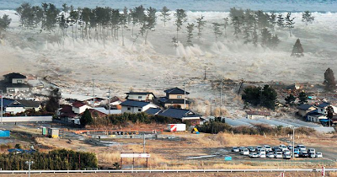
Let`s practice…
Imagine you are Sam and you had a small moment to write a letter and hide it in a safe (coffre fort) to explain to the world what happened that morning in Phuket,Thailand.

Slide 7
Motivation(Why?):
Emotions(What are you feeling and why?):
Description of Thailand:
Expectations (What do you expect to happen?):

Slide 8
Criteria | 5 | 4 | 3 | 2 | 1-0
Emotions | Character`s emotions are well explored and mentioned. | Character`s emotion are adequately explored. | Character`s emotions are present. | Character`s emotions are few or lacking. | Character`s emotion are not present.
Description of Thailand | Description of Thailand is present and relevant to the chapter. | Description is adequately present and relevant to the chapter. | Description is present. | Description is somewhat present and somewhat relevant to the chapter | Description is not present or is not at all relevant to the chapter.
Expectations | Character`s expectations are present and clear. | Expectations are adequately present. | Expectations are present. | Expectations are somewhat present. | Expectations are not present.
Use of Descriptive Language | Student utilizes excellent descriptive language | Student utilizes adequate descriptive language | Student utilizes descriptive language | Student utilizes some descriptive language | Student does not or rarely utilizes descriptive language

Slide 9
FOR NEXT CLASS…
Bring a dictionary!
Bring Wave !
Highlight (souligné)any information that will help you organize your ideas for the text.

