Slide 1
BRANDED
ERIC WALTERS

Slide 2
MOST COMMON HIGHSCHOOL ISSUES
WHO IS DATING WHO ? <3
WHO IS THE MOST POPULAR ? ☺
WHO IS THE SMARTEST ?
WHY DO WE GET A LOT OF HOMEWORK ? ☹
WHY IS THERE SO MUCH PRESSURE ? :s
. . . . . .
6. WHY DO WE HAVE TO WEAR SCHOOL UNIFORMS ?

Slide 3
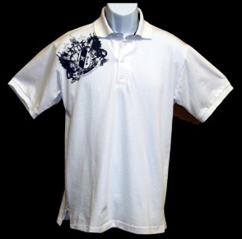
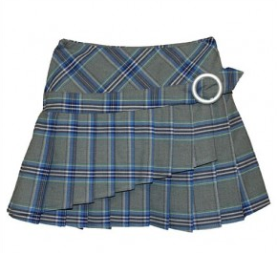
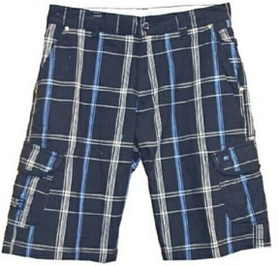
6. UNIFORMS
The word « uniform » means: identical, constant, little variation, straight.

Slide 4
Positive Aspects
Easy to recognize students (for security reasons)
Takes less time to figure out what to wear.
No one judges people based on what type of clothes they wear.
School seems more « uniform » and together as a whole.
WHAT ARE POSITIVE ASPECTS OF WEARING UNIFORMS ?

Slide 5
Negative Aspects
No personal identity.
After 5 years, the uniforms tend to always look the same. Students become tired of seeing it by the end of secondary 5.
Becomes expensive as students are constantly growing (Sec 1 – size 2) --» (Sec 5 – size 4)
WHAT ARE THE NEGATIVE ASPECTS OF WEARING UNIFORMS?

Slide 6
BRANDED by Eric Walters
Ian`s principal announces that the school is implementing uniforms, and Ian finds himself caught in a conflict. His friend Julia wants him to construct a plan to fight the decision, and the principal is determined to convince Ian the uniforms are a good idea. However, Ian will soon discover that there is a secret involving the production of the uniforms…

Slide 7
SETTING & CHARACTERS
Setting: Canadian Highschool, Social Justice Class, 2012
CHARACTER’S NAME | WHO THEY ARE
Ian | The main character who listens to two sides of a story before making a decision.
Julia | Ian’s friend who is the school president and has strong opinions.
Oswald | Ian’s friend who is the typical unmotivated student and makes jokes all the time.
Mr. Roberts | The school principal and social justice class teacher.

Slide 8
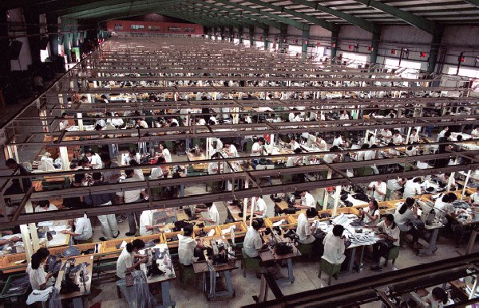
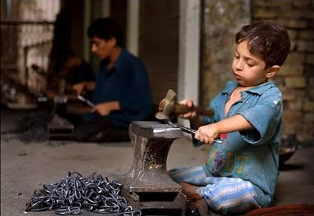
SWEAT SHOPS
CHILD LABOR
HUMAN RIGHTS

Slide 9
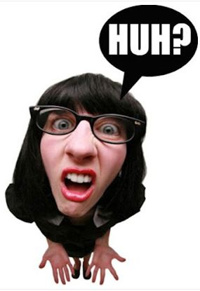
Sweat Shops, Child Labor, Human Rights
WHAT ARE YOU TALKING ABOUT !!!!

Slide 10
SWEAT SHOPS
Any workplace that has dangerous working conditions, low pay and long hours.
Examples: Abercrombie and Fitch, Hanes, Ikea, Kohl’s, Pier 1 Imports, Walmart American Apparel
Internation Labor Rights Forum (November 2009)

Slide 11
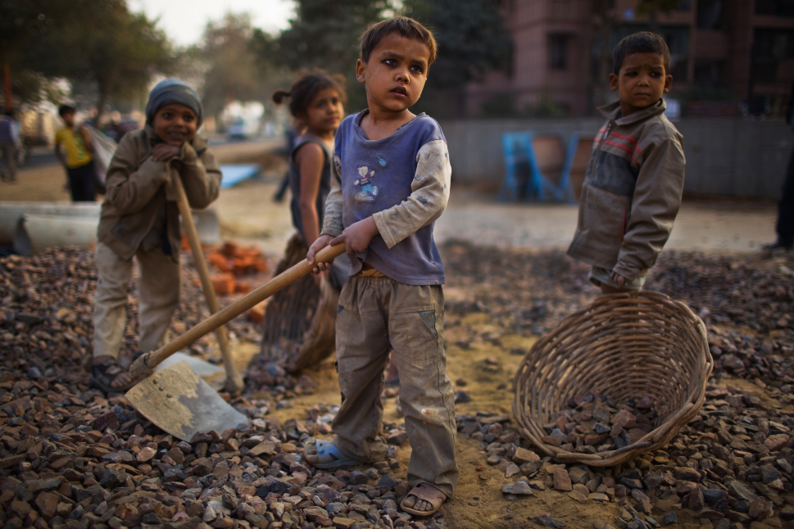
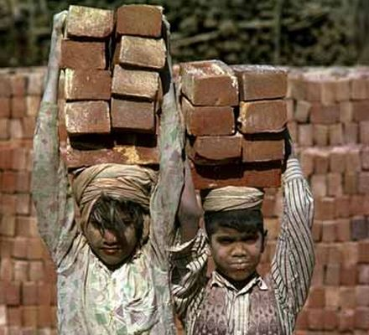
CHILD LABOR
Refers to the employment of children in any work that takes away a child`s childhood, interferes with their ability to attend regular school, and that is mentally, physically, socially or morally dangerous and harmful.

Slide 12
HUMAN RIGHTS
These are rights that every human being in the whole world has. It is universal (everywhere) and equal (for everyone).

Slide 13
HOMEWORK
READ CHAPTER 2
LIST THE CHARACTER FROM CHAPTER 1 /2
GRAMMAR TEST ON SIMPLE PRESENT/PAST 35: SEPTEMBER 22ND (MONDAY) 79: SEPTEMBER 18TH (THURSDAY)

