Slide 1
Natural Disaster News Report Project
Wave Project C3

Slide 2
What is a Natural Disaster? (catastrophe naturelle)
It is a natural event such as a flood, earthquake, or hurricane that causes great damage or loss of life.
Flood: Inondation Earthquake: Tremblement de Terre Hurricane: Ouragan Tornado: Tornade Volcanic Eruption: Éruption Volcanique

Slide 3
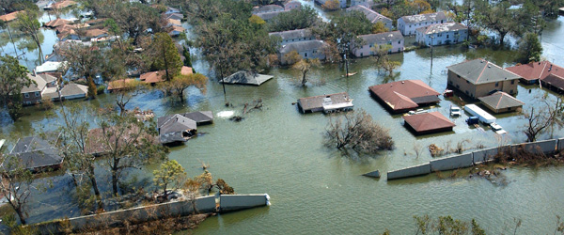
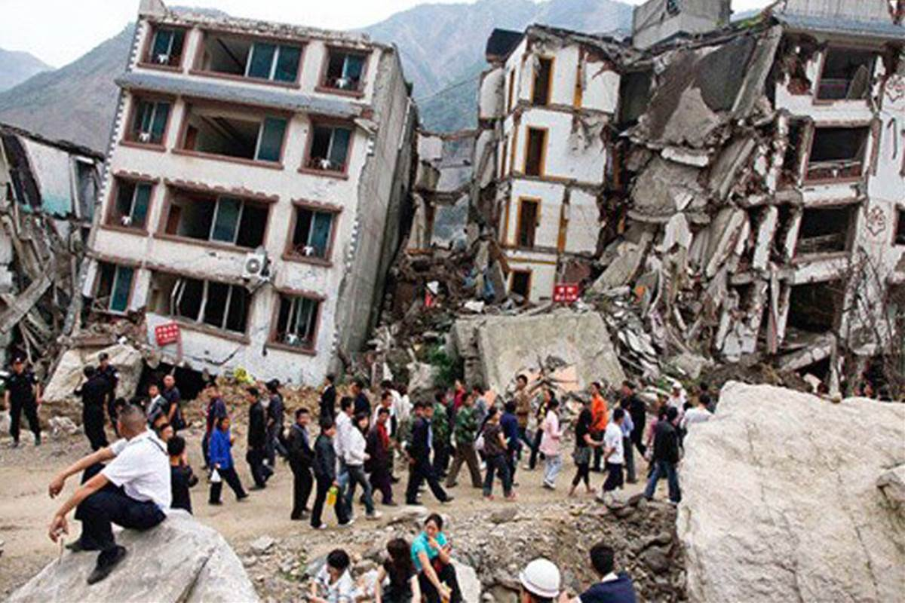
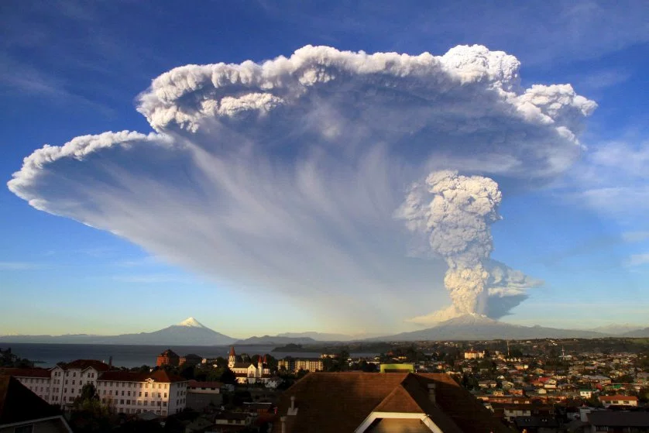
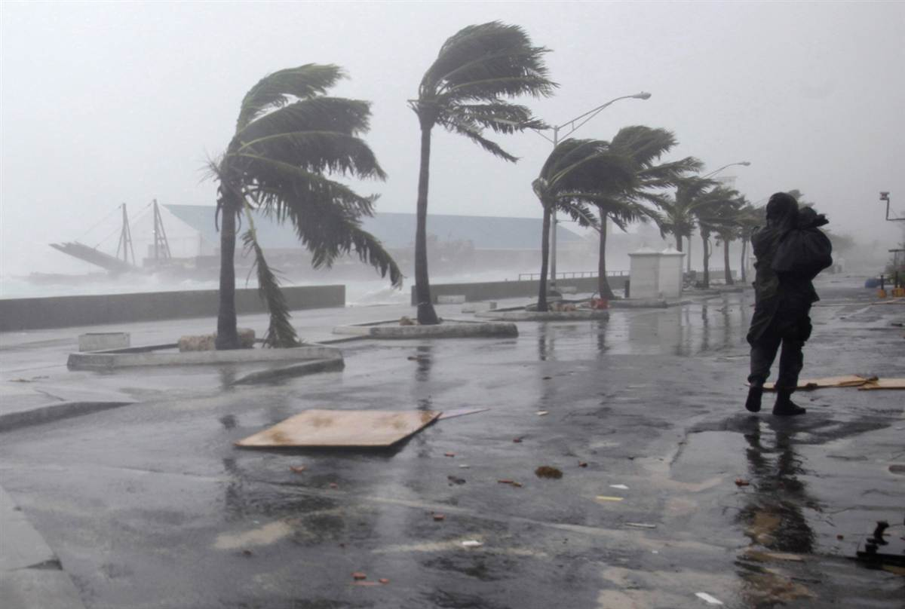
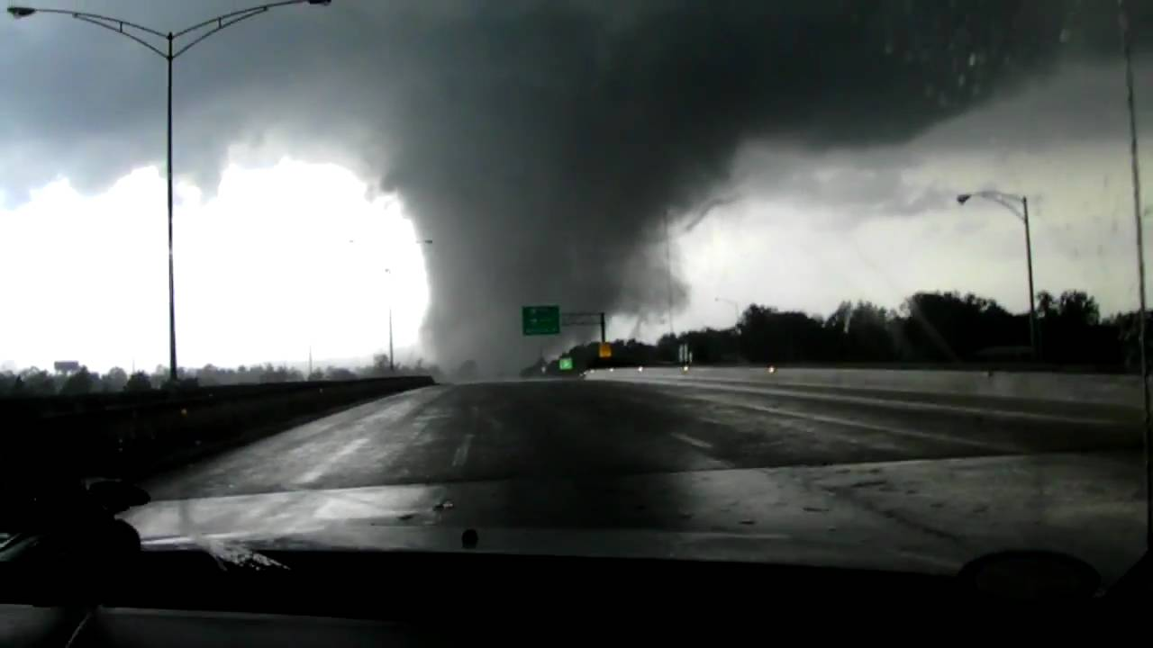

Slide 4
Actual Footage
Hurricane: https://www.youtube.com/watch?v=QDFK40UMotc
Flood: https://www.youtube.com/watch?v=iqaHyOVz_p0
Tornado: https://www.youtube.com/watch?v=bjb7QtMEBUg
Earthquake: https://www.youtube.com/watch?v=Xr6CFIHJvhw
Volcanic Eruption: https://www.youtube.com/watch?v=6Ys7uPivBLg
Tsunami: https://www.youtube.com/watch?v=fTn0UWMXpgo&t=302s

Slide 5
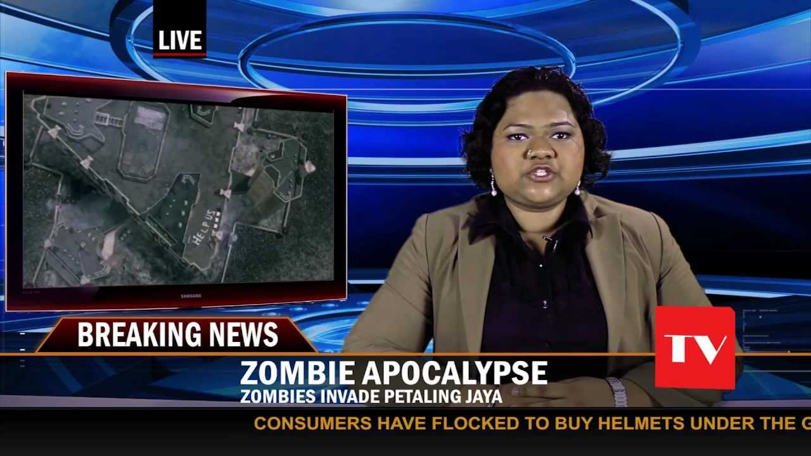
The News Report Project
In groups of 2 or 3, you will create a news report (reportage) about a natural disaster.

Slide 6
To Do List:
1) Choose a natural disaster (You cannot choose the 2004 Boxing Day Tsunami)
2) Inform the audience about the disaster
3) Talk to a witness
4) Provide solutions or preventions to the disaster.

Slide 7
1. Choose a Natural Disaster
You can choose ANY natural disaster. However, it is first come first serve. You need to tell me which natural disaster you want to choose. You must include on the list:
Type of Disaster / Country/ Year

Slide 8
2. Inform the audience about the disaster
This information must include: a) Date of the disaster (month, date, year) b) Give a brief definition or explanation of the disaster c) Short information about the country and the map d) Statistics (How many people died? What kind of damage is present?) e) Include video, pictures, some creativity f) Talk to a witness/survivor (témoin/survivant) (See next slide for more info) g) Finish the report with solutions or prevention ideas (see next slide for more info)

Slide 9
3. Talk to a Witness/Survivor
Talk to a witness/survivor (témoin/survivant) about what happened.
They could mention: What were they doing? How did they feel? What did they see?

Slide 10
4. Provide solutions and prevention ideas
When you are almost done your report, you will need to tell people what they should do if they face a disaster like the one mentioned and what they can do to help.

Slide 11
How Can You Present Your News Report?
Windows Moviemaker
Present it LIVE (en direct) with Powerpoint/Prezi/Google Presentations

Slide 12
Example
https://www.youtube.com/watch?v=yIKi1b5QvQU

Slide 13
When is it due?
Group 224 & 279: Friday, January 13th, 2017 Monday, January 16th, 2017 Wednesday, January 18th, 2017

Slide 14
Groups of 2 - 3
Windows Moviemaker
Present it LIVE (en direct) with Powerpoint/Prezi/Google Presentations
Friday, January 13th, 2017 Monday, January 16th, 2017 Wednesday, January 18th, 2017
1) Choose a natural disaster (You cannot choose the 2004 Boxing Day Tsunami)
2) Inform the audience about the disaster a) Date of the disaster (month, date, year) b) Give a brief definition or explanation of the disaster c) Short information about the country and the map d) Statistics (How many people died? What kind of damage is present?) e) Include video, pictures, some creativity
3) Talk to a witness What were they doing? How did they feel? What did they see?
4) Provide solutions or preventions to the disaster.

