Slide 1
Prepositions
Lesson and activities

Slide 2
What is a preposition?
A preposition is a word that connects nouns and pronouns to other words in a sentence.
A preposition introduces an object in a sentence.
A preposition indicates the relationship between its object to the rest of the sentence.

Slide 3
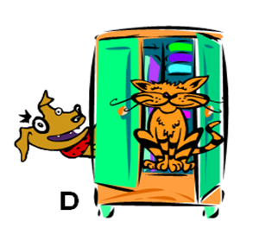
Prepositions of Place
The cat is inside the dresser.
The dog is outside the dresser.

Slide 4

Prepositions of place
The dog is beside the stereo.
The dog is near the stereo.

Slide 5

Prepositions of Place
The cat is on the table.
The cat is on top of the table.

Slide 6

Prepositions of Place
The bookshelf is between the cats.

Slide 7
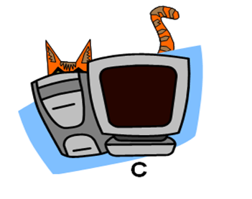
Prepositions of place
The cat is behind the computer.

Slide 8

Prepositions of Place
The dog is in front of the painting.

Slide 9

Prepositions of place
The cat is sitting under the dog.
The dog is sitting above the cat.

Slide 10
PREPOSITIONS OF PLACE
ENGLISH | FRENCH
INSIDE / OUTSIDE | DEDANS / DEHORS
BESIDE / NEAR | À CÔTÉ / PROCHE
ON / ON TOP OF | SUR / AU DESSUS
BETWEEN | ENTRE
BEHIND | EN ARRIÈRE
IN FRONT OF | DEVANT
UNDER / ABOVE | EN DESSOUS / EN HAUT

Slide 11
Activity #1
With the person sitting next to you,
write a sentence with a preposition to describe the place of the objects in the picture (next slide)

Slide 12
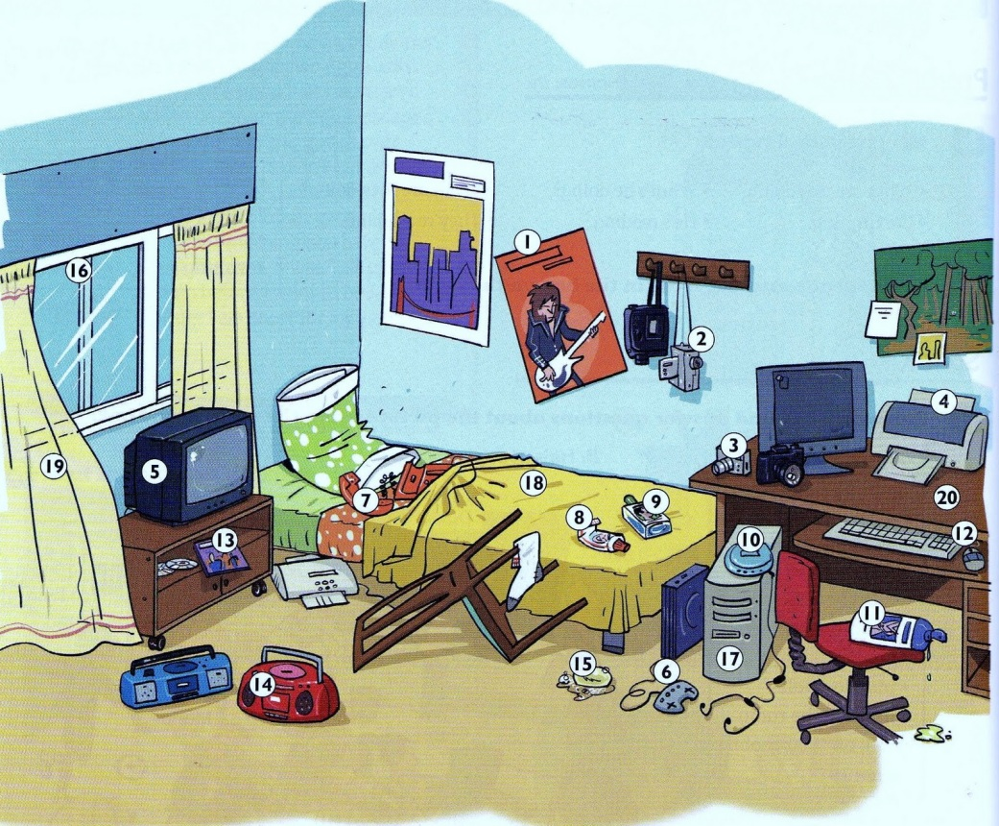

Slide 13
THE LIST OF OBJECTS FROM THE PICTURES
11. Shampoo
12. Keyboard
13. DVD/Video game
14. Radio
15. Turtle/Hat/Soap
16. Window
17. Computer tower
18. Blanket
19. Curtain
20. Desk
Poster
Video camera
Camera
Printer
Television
Video game controller
Telephone
Toothpaste
Sunscreen
Walkman/Discman

Slide 14
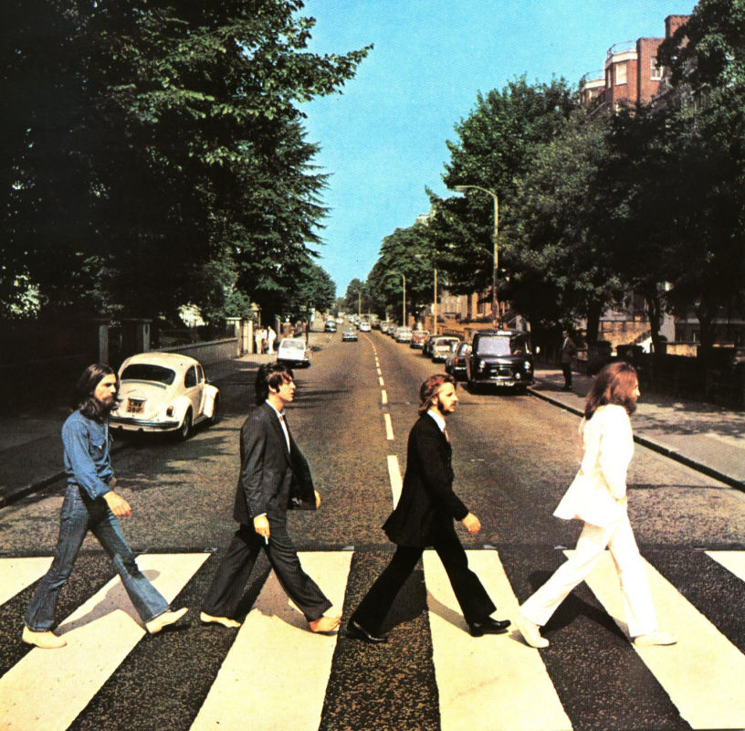
Prepositions of Movement
The Beatles are walking across the street.

Slide 15

Prepositions of DIRECTION
The plane is flying around the world.

Slide 16
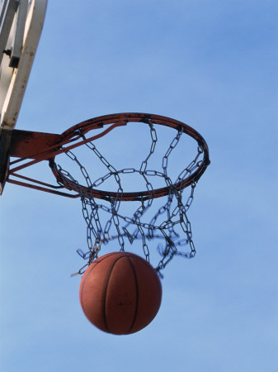
Prepositions of DIRECTION
The ball went through the hoop.

Slide 17
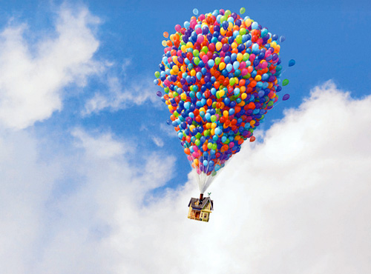
Prepositions of DIRECTION
The house is floating up in the air.

Slide 18

Prepositions of DIRECTION
The boy is walking to school.

Slide 19
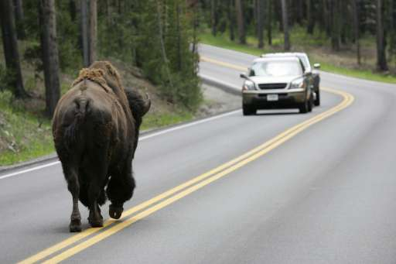
Prepositions of DIRECTION
The car is driving toward the buffalo.

Slide 20
Prepositions of DIRECTION
To=Destination
I am walking to class.
Toward=direction
The tiger is running toward the rabbit.

Slide 21
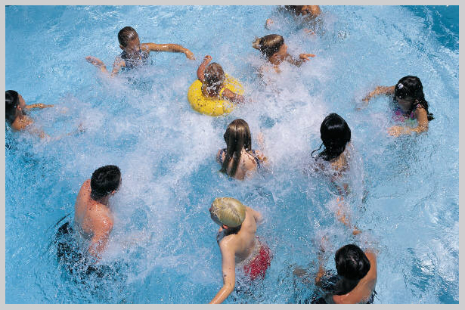
Prepositions of DIRECTION
The children are swimming in the pool.

Slide 22
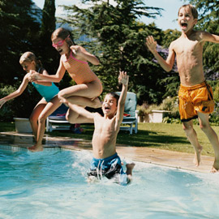
Prepositions of movement
The children are jumping into the pool.

Slide 23
Prepositions of movement
In=State
I am sitting in class.
Into=Action
I walked into the store.

Slide 24
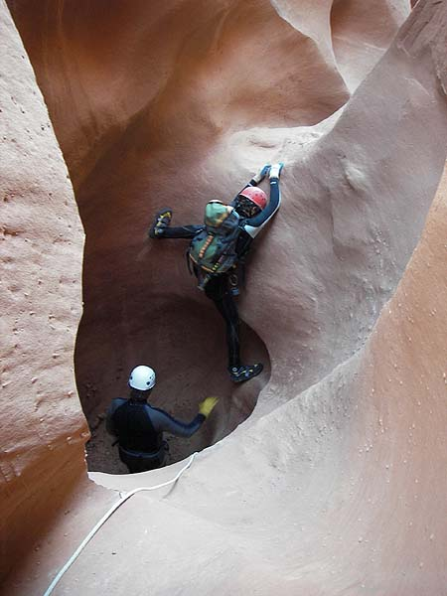
Prepositions of movement
The man is climbing out of the cave.

Slide 25
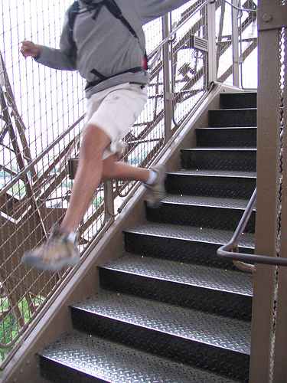
Prepositions of DIRECTION
The man is running down the stairs.

Slide 26
PREPOSITIONS OF DIRECTION
ENGLISH | FRENCH
ACROSS | TRAVERS
AROUND | AUTOUR
THROUGH | PAR/À TRAVERS
UP/DOWN | EN HAUT / EN BAS
TO | À
TOWARD | VERS
IN | DANS
INTO | DANS / EN
OUT OF | HORS DE / EN DEHORS DE

Slide 27
In, on or at?
PREPOSITION | WHEN TO USE | EXAMPLE
IN | Names of towns, provinces, states or countries. | I live in Lac St-Jean.
ON | Name of steets | She lives on Brown street.
AT | House number and street, location | He lives at 23 victoria street.

Slide 28
At, In or To?
PREPOSITIONS | WHEN TO USE | EXAMPLE
AT | Location in general | We are at home.
IN | Specific place inside. | We are in a kitchen.
TO | After verbs of motion: go, come, move, run, walk | They are moving to Ontario.

Slide 29
In, on or at?
PREPOSITIONS | WHEN TO USE | EXAMPLE
IN | Months, years | My birthday is in January.
ON | Days, dates | We`ll be there on Monday.
AT | Time | The game starts at 7:30.

Slide 30
COMPLETE PAGES IN GRAMMAR BOOK:
P. 172, 173, 174

