Slide 1
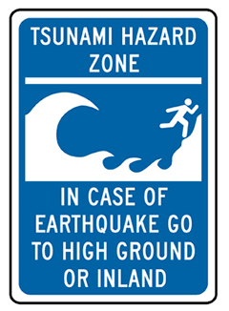
TSUNAMI

Slide 2
WHAT IS A TSUNAMI?
https://edpuzzle.com/media/58050a96411d93293f9804fe

Slide 3
TSUNAMI IN POP CULTURE
https://www.youtube.com/watch?v=uCqUoPaaH0I&list=PLyQf4cceF4xZLD_Rew4TPz87xIvvUnPOM&index=3&t=7s (The Impossible 2012)
https://www.youtube.com/watch?v=2t0zQ9RmYSc&list=PLyQf4cceF4xZLD_Rew4TPz87xIvvUnPOM&index=2 (Hereafter 2010)
https://www.youtube.com/watch?v=6_oK8qm91Ys&list=PLyQf4cceF4xZLD_Rew4TPz87xIvvUnPOM&index=1 (San Andreas 2015)

Slide 4
QUESTIONS TO THINK ABOUT
WHAT WERE TWO SIGNS THAT A TSUNAMI WAS ABOUT TO HAPPEN?
WHAT SHOULD YOU DO IF A TSUNAMI IS ABOUT TO ARRIVE?
MANY PEOPLE DIED IN THE TSUNAMI. WHAT ARE THE TWO WAYS THAT THEY MIGHT HAVE DIED IN THE TSUNAMI?
WHAT IS AN EXAMPLE OF BRAVERY/COURAGE IN THE NOVEL?
WHAT IS TYPE OF CONFLICT IS FOUND IN CHAPTER 6?
WHAT PART OF THE PLOT STRUCTURE IS CHAPTER 6?

Slide 5
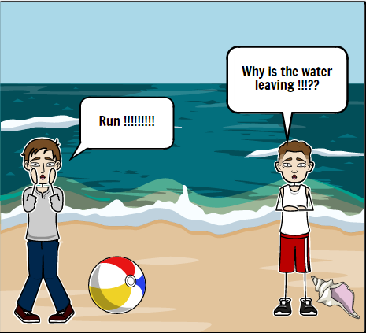
STORYBOARD THAT https://www.storyboardthat.com/storyboard-creator
IN TEAMS OF 2, USING THE WEBSITE « STORYBOARD THAT », CREATE A CARTOON VERSION OF EITHER: CHAPTER 5 (P.47 – 60) (ELEPHANT RIDE + WATER BEGINNING TO VANISH)
CHAPTER 6 (P. 61 – 75) (WAVE + HELPING PEOPLE + HELPING THE MOTHER WITH THE HOSE)
CHAPTER 7 (P.76 – 86) (TRYING TO GET THEIR BELONGINGS + THE WATER VANISHES AGAIN) YOU NEED TO INCLUDE: THE CHARACTERS DIALOGUE THREE DIFFERENT SETTINGS

