Slide 1
COMPARATIVE & SUPERLATIVE
ADJECTIVE GRAMMAR NOTES

Slide 2
DEFINITION
USED ONLY WITH ADJECTIVES
COMPARATIVE: TO COMPARE
SUPERLATIVE: EXTREME

Slide 3
COMPARATIVE
1) ADJECTIVE WITH TWO OR THREE SYLLABLES RULE: MORE + (ADJ) + THAN FAMOUS → MORE FAMOUS THAN
2) ADJECTIVE WITH TWO SYLLABLES ENDING IN A CONSONANT+Y RULE: REMOVE `Y` AND + IER + THAN PRETTY → PRETTIER THAN
3) ADJECTIVE WITH ONE SYLLABLE (consonant-vowel-consonant) RULE: ADD THE LAST LETTER OF THE WORD + ER + THAN BIG → BIGGER THAN
4) ADJECTIVE WITH ONE SYLLABLE RULE: ADD –ER TO THE ADJECTIVE + THAN
OLD → OLDER THAN

Slide 4
PRACTICE
1- FAST
2- SMALL
3- HANDSOME
4- FUNNY
5- HOT
6- SAD

Slide 5
SUPERLATIVE
1) ADJECTIVE WITH TWO SYLLABLES OR THREE SYLLABLES RULE: ADD (THE MOST) + ADJECTIVE FAMOUS → THE MOST FAMOUS
2) ADJECTIVE WITH TWO SYLLABLES ENDING IN A CONSONANT+Y RULE: THE + REMOVE THE `Y` AND ADD –IEST PRETTY → THE PRETTIEST
3) ADJECTIVE WITH ONE SYLLABLE (consonant-vowel-consonant) RULE: ADD (THE) + ADJECTIVE + REPEAT LAST LETTER + EST BIG → THE BIGGEST
4) ADJECTIVE WITH ONE SYLLABLE RULE: ADD (THE) + ADJECTIVE + EST
OLD → THE OLDEST

Slide 6
PRACTICE
1- FAST
2- SMALL
3- HANDSOME
4- FUNNY
5- HOT
6- SAD

Slide 7
EQUIVALENT
When two things are equal or the same.
ex. glamorous
This hotel is as glamorous as that ferrari.
Rule: AS (adjective) AS

Slide 8
Exceptions GOOD VS BAD
 | GOOD | BAD
COMPARATIVE | BETTER THAN | THE BEST
SUPERLATIVE | WORSE THAN | THE WORST

Slide 9
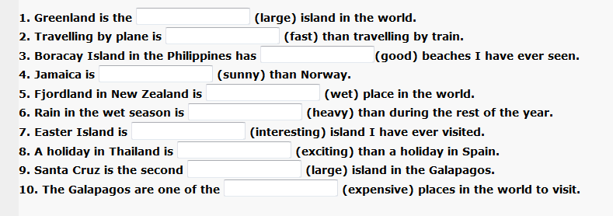
COMPARATIVE AND SUPERLATIVE PRACTICE

Slide 10
ANSWERS
LARGEST
FASTER
THE BEST
SUNNIER
THE WETTEST
HEAVIER
THE MOST INTERESTING
MORE EXCITING
LARGEST
MOST EXPENSIVE

Slide 11
GRAMMAR BOOK
PAGE 169 + 170 (#1, #2) IN YOUR GRAMMAR ACTIVITY BOOK

