Slide 1
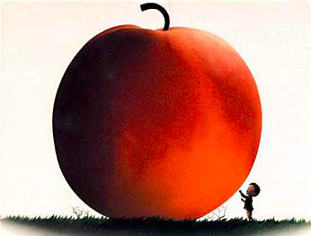
JAMES AND THE GIANT PEACH Roald Dahl

Slide 2
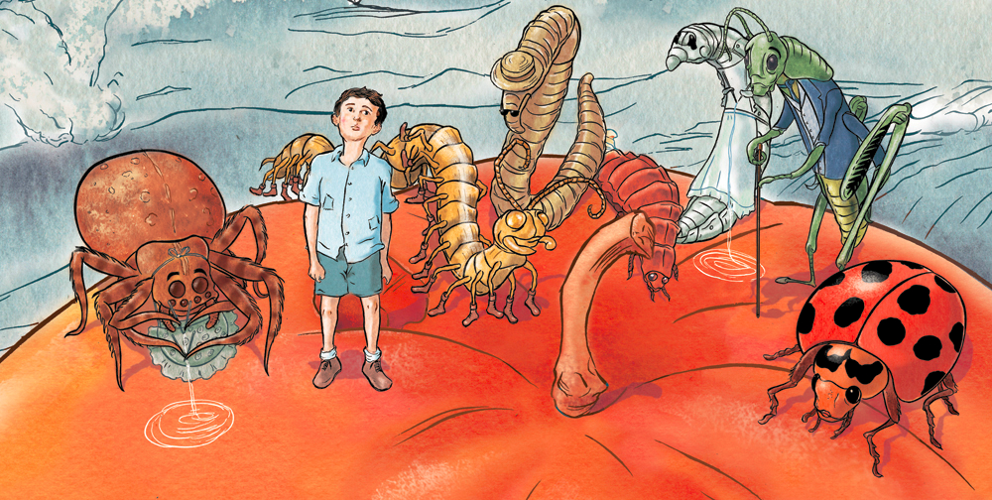
THE STORY…
The story focuses on a young English orphan boy named James Henry Trotter who enters a gigantic, magical peach, and has a wild cross-world adventure with six magically-altered creatures he meets.

Slide 3
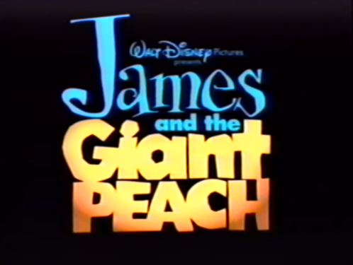
SNEAK PEAK
https://www.youtube.com/watch?v=iqrGesf2xbg

Slide 4
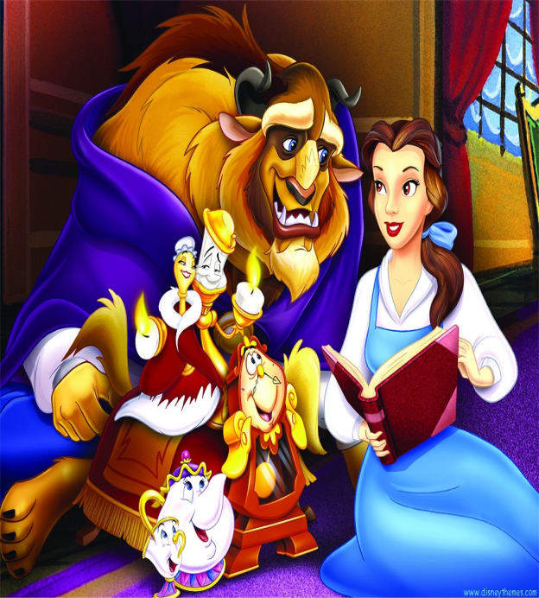
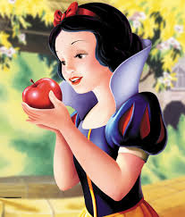
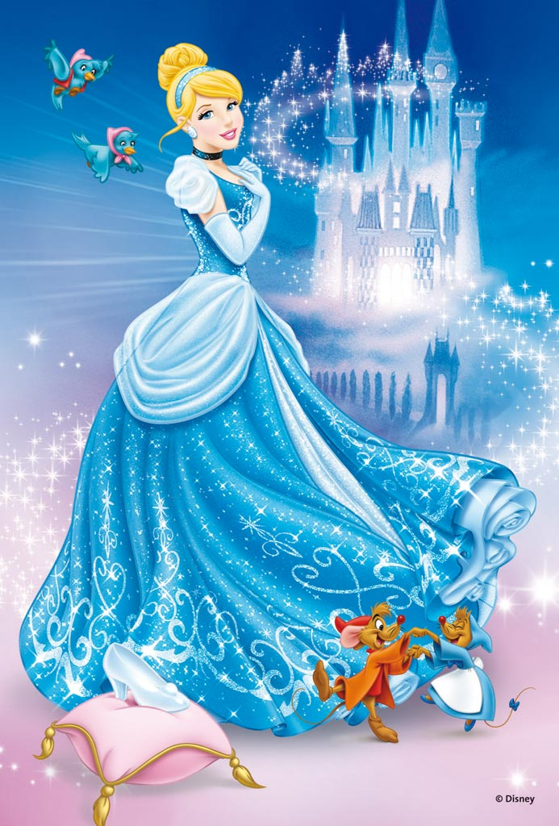
DID YOU KNOW ?
THE PLOT STRUCTURE OF EVERY DISNEY FAIRY TALE IS PRACTICALLY THE SAME.

Slide 5
DISNEY PLOT STRUCTURE
DEATH OF A PARENT (S)
SAD LIFE FOR MAIN CHARACTER
SOMETHING SPECIAL OR INTERESTING HAPPENS
ADVENTURE BEGINS

Slide 6
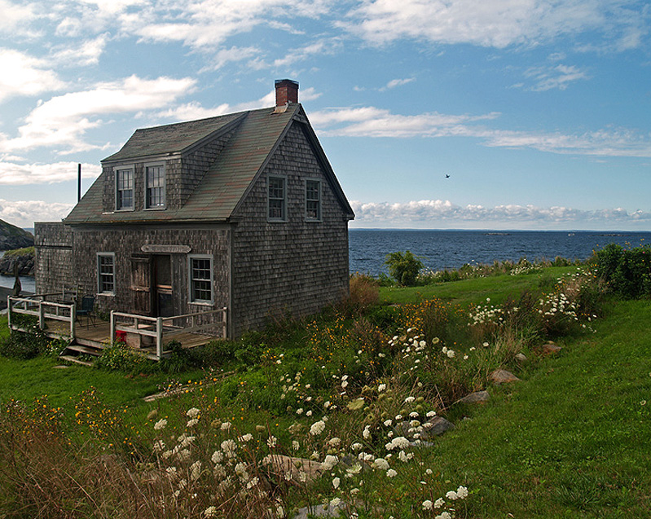
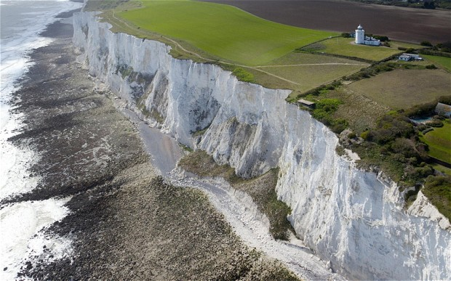
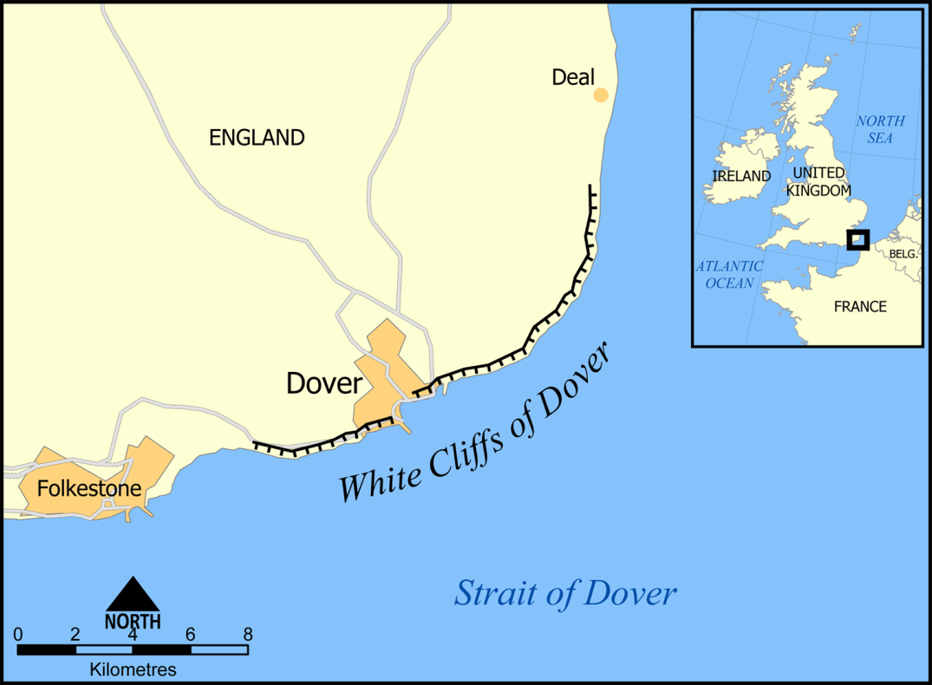
THE SETTING
Cottage by the sea
South of London

Slide 7
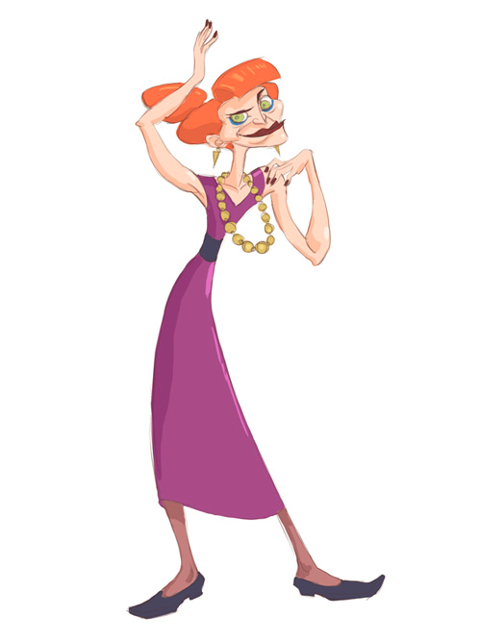
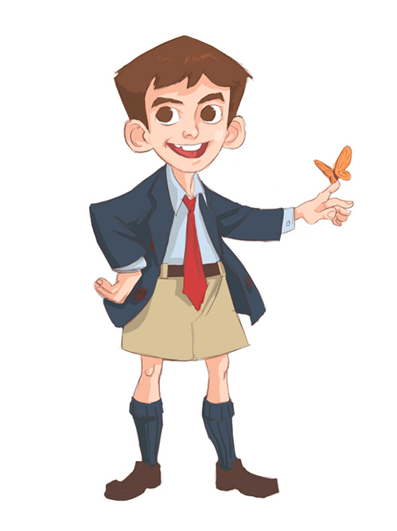
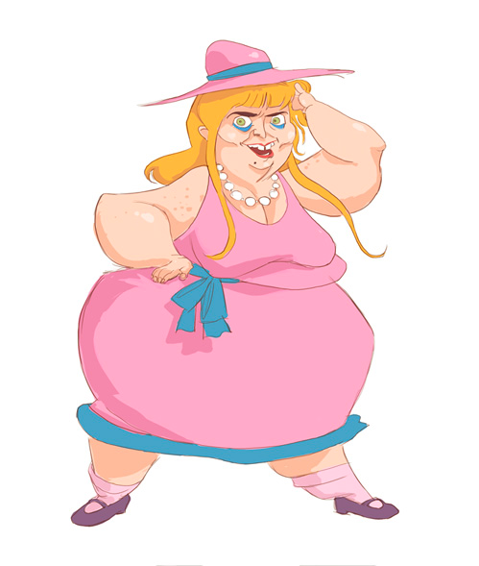
THE CHARACTERS – THE HUMANS
AUNT SPIKER
JAMES HENRY TROTTER
AUNT SPONGE

Slide 8
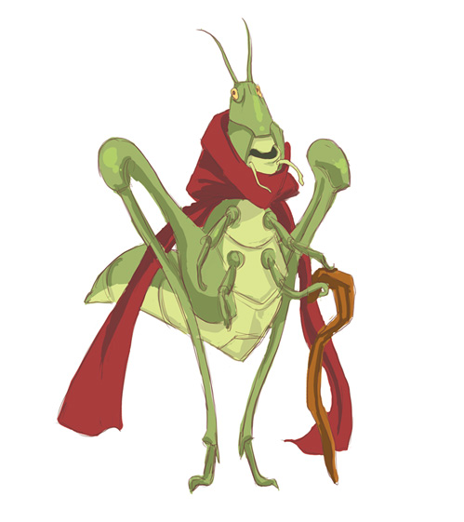
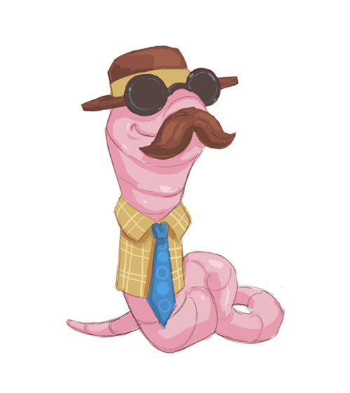
THE CHARACTERS – THE INSECTS
THE OLD GREEN GRASSHOPPER
THE CENTIPEDE
THE EARTHWORM

Slide 9
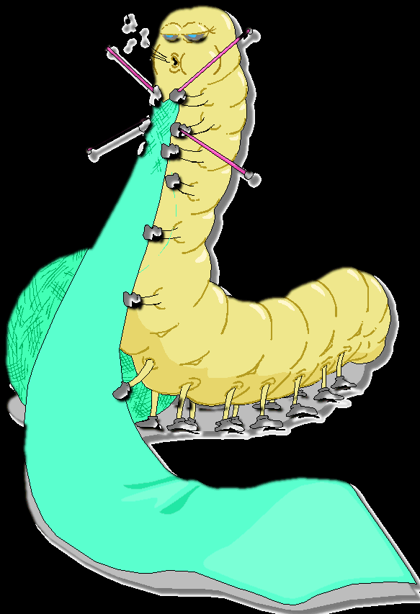
THE CHARACTERS – THE INSECTS
MISS SPIDER
GLOW WORM
LADYBUG
SILKWORM

Slide 10
THE PEACH
THIS PEACH WILL BE : A SETTING A PROBLEM A SOLUTION.
YOU WILL SOON FIND OUT WHY…

Slide 11
TYPES OF EVALUATIONS
Two Discussions Based on Novel C1
2 TESTS C2 FIRST PART OF THE NOVEL SECOND PART OF THE NOVEL
JGP Project C2/C3 Travel Diary
Argumentative Essay/Paragraph C3

