Slide 1
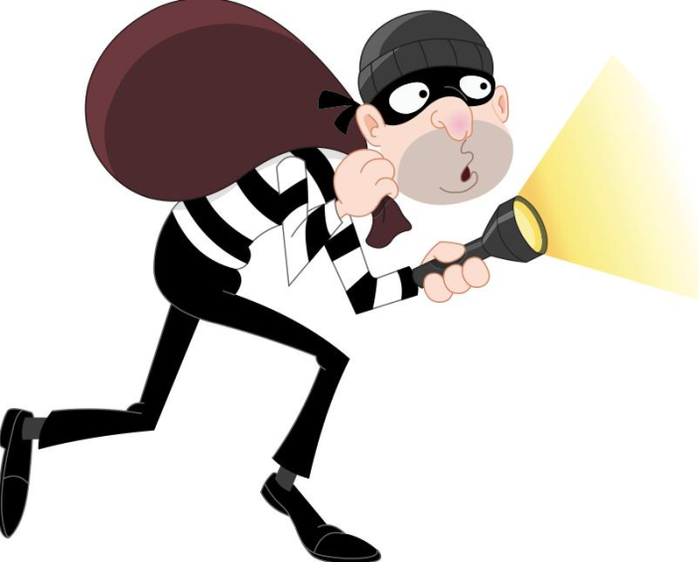
TONGUE TWISTER OF THE DAY
Three thin thieves thought a thousand thoughts.
If three thin thieves thought a thousand thoughts how many thoughts did each thief think?

Slide 2
THE LITERARY FOUR Four Literary Devices Most Commonly Used
SITUATIONAL IRONY, FORESHADOWING, METAPHOR, HYPERBOLE

Slide 3
SITUATIONAL IRONY
A contradiction or sharp contrast of a situation.
http://www.youtube.com/watch?v=fEUsHnae7z0
The police station was robbed. Situation: The police station protects people from robbers. Contradiction: The police station was robbed.

Slide 4
BUTTON, BUTTON
In the short story, the deal for Norma was that she can win $50,000 if she presses the button and kill someone she does NOT know.
Situation: Norma has a choice to kill someone she does not know. Contradiction: The person that she killed was her husband.

Slide 5
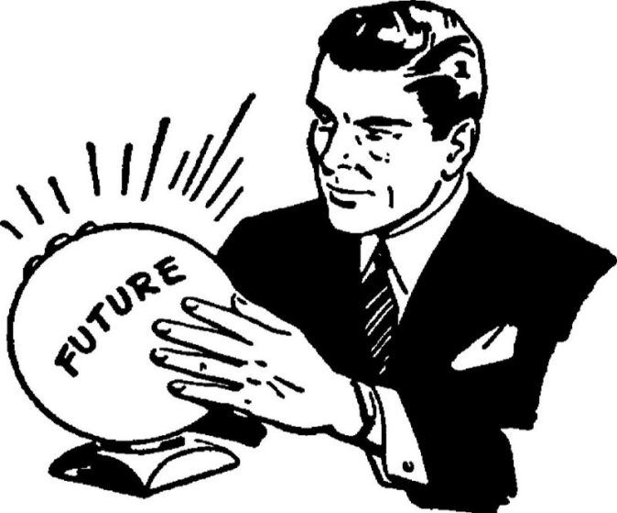
FORESHADOWING
An author hints or suggests certain plot events that might come later in the story. (something will happen or affect the future)
http://www.youtube.com/watch?v=lP4Psj7d1ZI

Slide 6
HYPERBOLE
An exaggeration to give a heightened effect
I’ve told you a million times
Her brain is the size of a pea
Jake said his mom is going to kill him.

Slide 7
SITUATIONAL IRONY ? FORESHADOWING ? HYPERBOLE ? ACTIVITY

Slide 8
In the following passage, identify TWO examples of literary terms from the passage below:
Timmy`s morning did not start well. Timmy was rushing to get ready for his first day of high school. He felt like a million dollars with his new shirt tucked in and new shoes cleaned. Timmy was very nervous. As he stepped out of his house to run for the bus, he heard a loud thud. Timmy looked and saw to his horror that he forgot to close his school bag. He picked up his school books from the floor as fast as a man on fire. Once ready, he got on the bus. To his surprise, the bus driver told Timmy that there was no school today. and that the first day of school was in fact, the next day.

Slide 9
IRONY / FORESHADOWING / HYPERBOLE
Timmy`s morning did not start well. Timmy was rushing to get ready for his first day of high school. He felt like a million dollars with his new shirt tucked in and new shoes cleaned. Timmy was very nervous. As he stepped out of his house to run for the bus, he heard a loud thud. Timmy looked and saw to his horror that he forgot to close his school bag. He picked up his school books from the floor as fast as a man on fire. Once ready, he got on the bus. To his surprise, the bus driver told Timmy that there was no school today. and that the first day of school was in fact, the next day.

Slide 10
SITUATIONAL IRONY ? FORESHADOWING ? HYPERBOLE ? PICTURE ACTIVITY

Slide 11
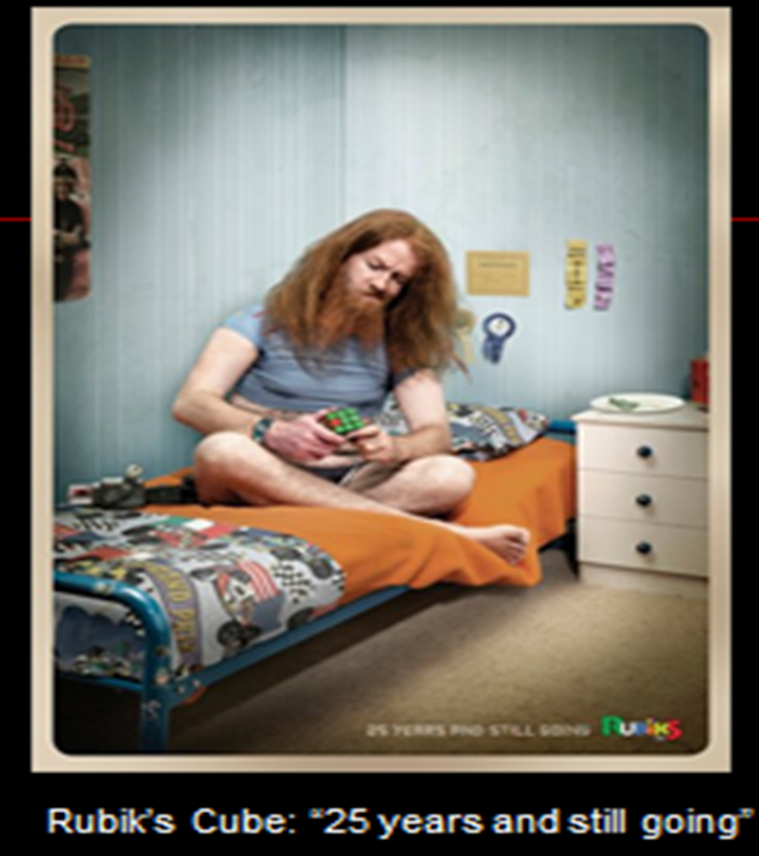

Slide 12
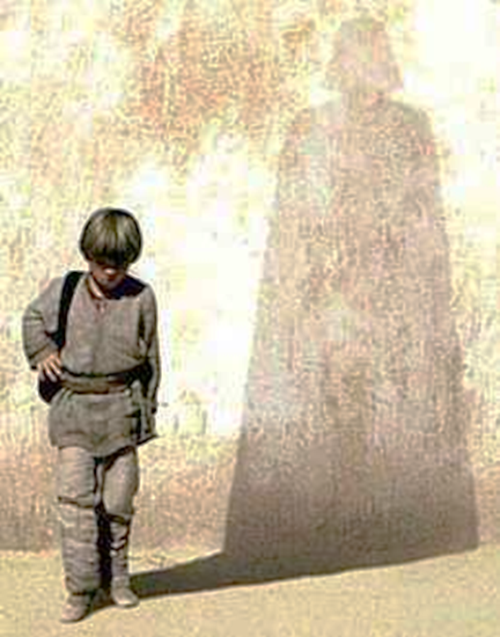

Slide 13
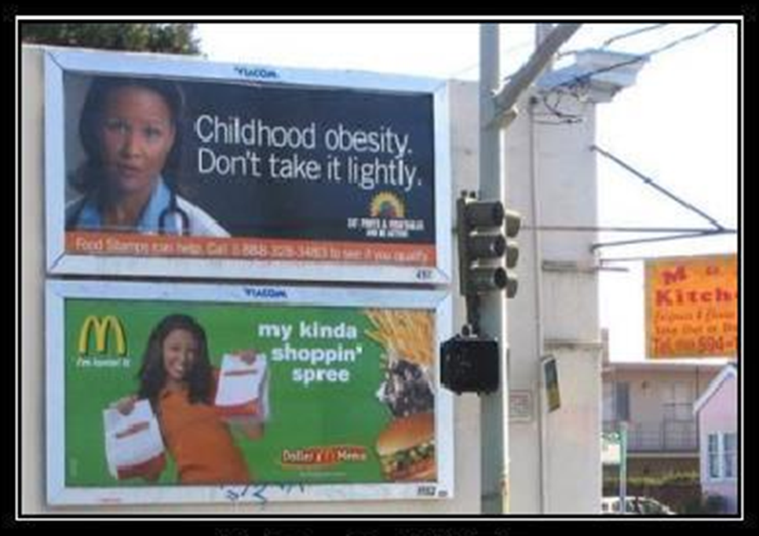

Slide 14
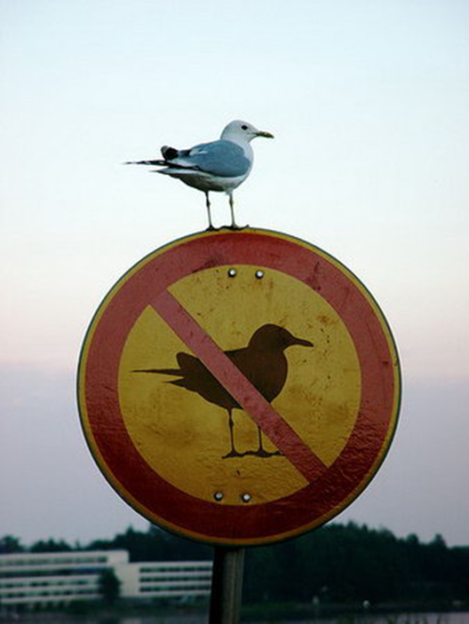

Slide 16
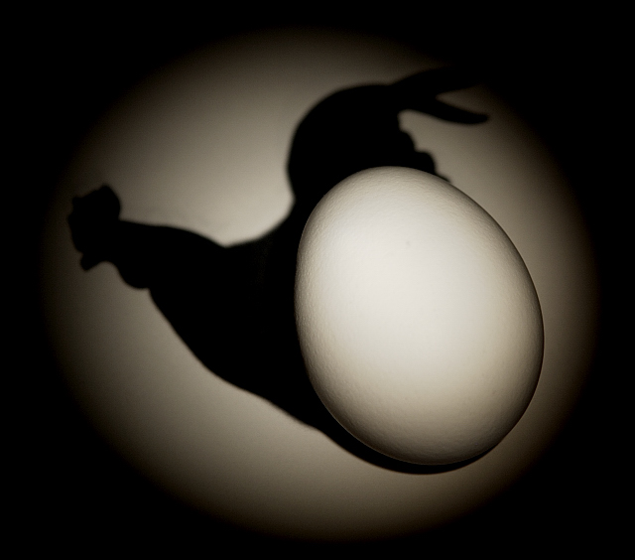

Slide 17
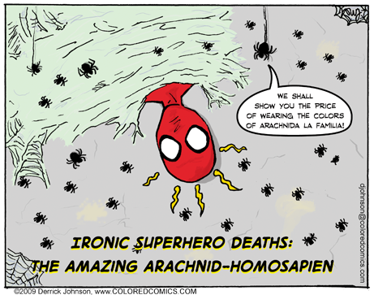
Spider-Man is in TROUBLE !!!

Slide 18
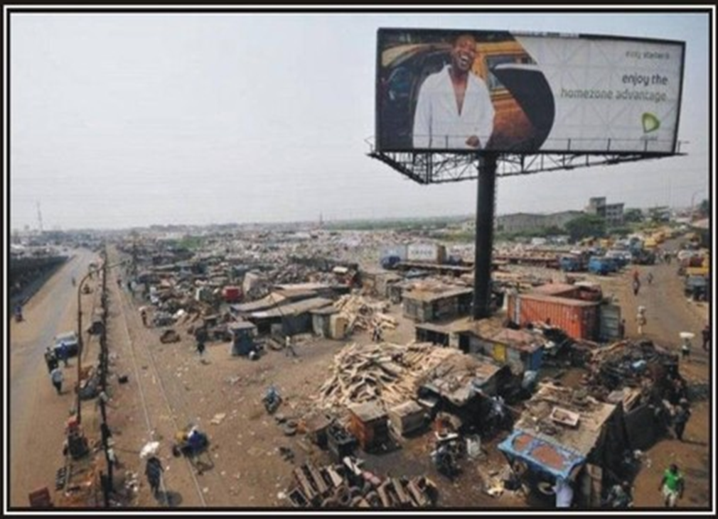

Slide 19
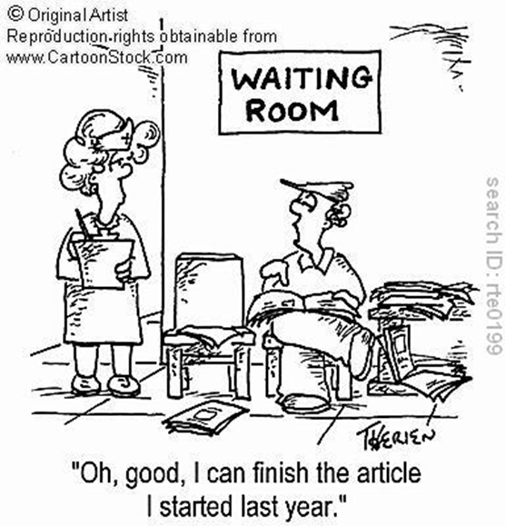

Slide 20
SITUATIONAL IRONY ? FORESHADOWING ? HYPERBOLE ? VIDEO CLIP ACTIVITY

Slide 21
THE VIDEO CLIPS
http://www.youtube.com/watch?v=bvBVGeNY1W4
http://www.youtube.com/watch?v=2ycgsDIQVDs
http://www.youtube.com/watch?v=dHaH_aNTzDg&feature=related

Slide 22
SITUATIONAL IRONY ? FORESHADOWING ? HYPERBOLE ? QUESTION ACTIVITY

Slide 23
1. Which statement is a hyperbole ?
A) I ran as fast as a cheetah.
B) Mary arrived 4 hours late for work.
C) Tom is so hungry he can eat a horse.
D) It was a rainy Monday when Bob the dog ran away.

Slide 24
2. Which statement is NOT situational irony ?
A) Sarah was married the same day her parents got divorced.
B) It started raining so Tom decided to stay home.
C) The firestation caught on fire.
D) Jake wore his favorite t-shirt and lost the soccer game.

Slide 25
3. Which of the following examples demonstrates the literary device of foreshadowing?
a) Dante was sitting in a dark old house located at the very end of a dead- end street. It looked like his front lawn hadn’t been mown in months.
b) Adam didn’t like to spend money. He preferred to spend his hard-earned cash only on the basic necessities.
c) When Alex woke up that morning, it was raining outside.The weather was depressing. Alex was still excited to go to the Osheaga Concert.. That evening over dinner, his mother informed him that the concert was cancelled due to the heavy rainstorm.
d) Lisa thought to herself, "I hope she likes my cooking. I worked really hard on this lasagna. I felt like an Italian mother while I cooked all this food!”. When her friend arrived, she said that she had stopped by at a restaurant before coming over.

Slide 26
REVIEW
SITUATIONAL IRONY: A CONTRADICTION TO A SITUATION
FORESHADOWING: A HINT OF WHAT IS TO HAPPEN IN THE FUTURE
HYPERBOLE: AN EXAGGERATION

