Slide 1
PROTEST POSTER ACTIVITY C2

Slide 2
WHAT IS A PROTEST ?
A protest is an expression of words or by actions.
Protests can take many different forms: 1) individual statements 2) mass demonstrations (ex. flash mob)
Protesters want their opinions to be heard publicly.
Protesters want to influence public opinion or government policy. .

Slide 3
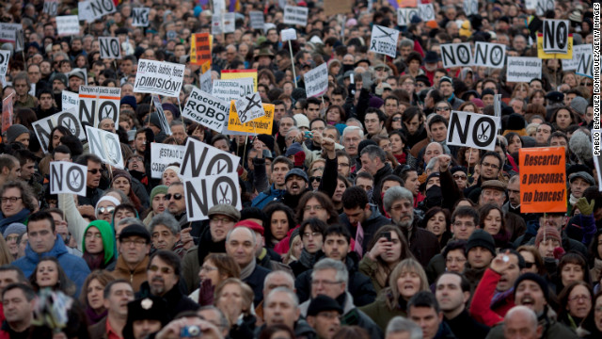
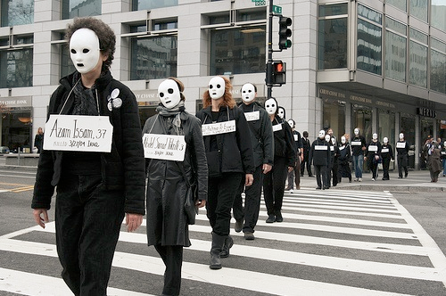
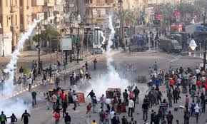
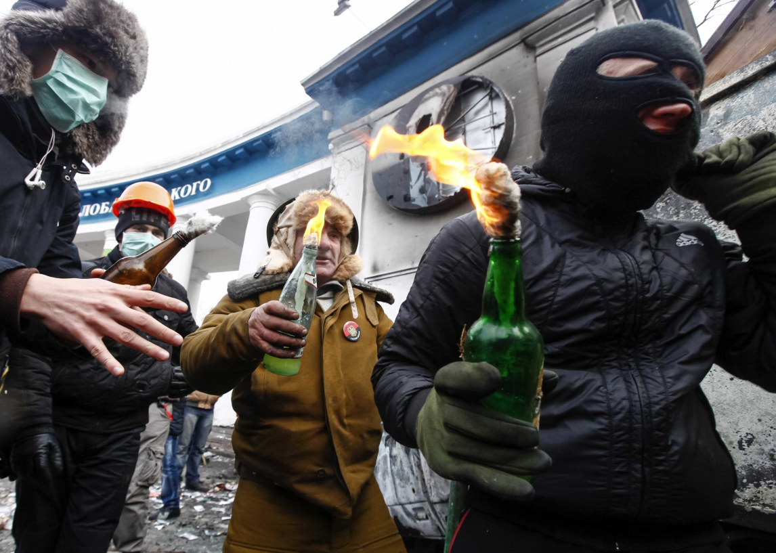

Slide 4
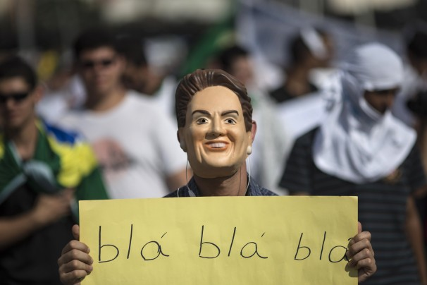
WORD DIFFERENCE
PROTEST : protestation
STRIKE: manifestation
Protest (verb): He is protesting against drunk driving.
Strike (noun): The teachers are on strike.

Slide 5
PROTEST REASON EXAMPLES
People can protest about anything they feel passionate about. The most popular protests are about: 1) Animal Cruelty (Vegetarian, Fur, Circus) 2) Drunk Driving 3) Occupy Wall Street 4) Gay Marriage 5) Equality (Race, Social Status) 6) Government Bills/Laws 7) Student Tax Tuition (Montreal May 2012) 8) Language 9) LGBT Rights 10) Global Warming / Environment

Slide 6
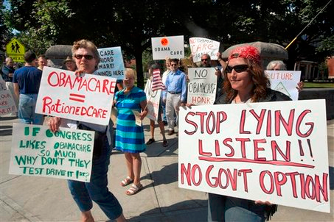
WHAT IS A PROTEST POSTER/SIGN ?
HAVE YOU EVER SEEN THIS ?

Slide 7
PROTEST POSTER/SIGN
PROTEST POSTER/SIGNS : are used in order to send a SHORT but DIRECT message out to the public about their social issue. It usually contains IMAGES, a CREATIVE way to say the message. It connects directly to what the person wants to say about the issue.

Slide 8
HERE ARE SOME EXAMPLES:

Slide 15
YOUR TASK:
MATERIALS NEEDED: COLORING CRAYONS OR MARKERS WHITE PAPER (PROVIDED BY ME)
1) YOU AND YOUR PARTNER WILL CHOOSE ANY SOCIAL ISSUE THAT BOTHERS YOU OR THAT YOU ARE PASSIONATE ABOUT. IF YOU DISLIKE FB, THEN YOU ARE PROTESTING AGAINST FB IF YOU BELIEVE IN EQUAL MARRIAGE THEN YOU ARE PROTESTING FOR EQUAL MARRIAGE. 2) YOU WILL THEN CREATE A PROTEST POSTER.

Slide 16
YOUR TASK (CONTINUED)
YOUR POSTER MUST CONTAIN: 1) ONE INTERESTING FACT OR STATISTIC ABOUT THE ISSUE THAT IS SHOCKING OR SURPRISING. 2) A CREATIVE IMAGE OR DESIGN (IT CAN BE SERIOUS, SCARY, FUNNY BUT NOT VULGAR) 3) A SHORT AND DIRECT SLOGAN THAT IS CONNECTED TO YOUR ISSUE.

Slide 17
YOU WILL THEN TAKE A PICTURE AND POST IT ON PADLET
http://fr.padlet.com/ranallidavid/e54bm260yufh (235)
http://fr.padlet.com/ranallidavid/61n1073vlcou (279)
Take a picture of your poster (with phone) Upload it to your computer Post it on PADLET Write your names and upload a youtube video that has information about your topic.

