Slide 1
SUMMARY / SYNOPSIS
Outlining & Summarizing a Text

Slide 2
WHAT IS A SUMMARY ?
A CONDENSED VERSION OF A LARGER TEXT
AN OUTLINE OF A PLAY, NOVEL, FILM, BOOK, STORY
10-15% OF A TEXT

Slide 3
PURPOSE
Your purpose in writing a summary is to give the basic ideas of the original reading in a shorter scale.
What was the story about ?
What did the author want to communicate?

Slide 4
EXAMPLES OF SUMMARIES
HERE ARE COMMON EXAMPLES OF SUMMARIES THAT YOU HAVE ALREADY COME ACROSS AND HAVE NOT EVEN NOTICED.

Slide 5
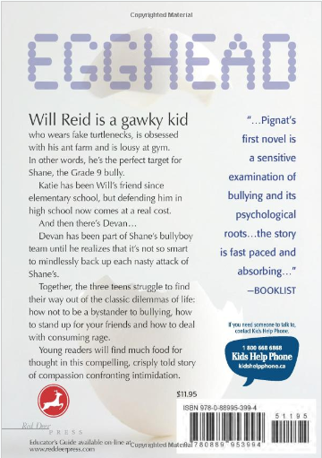
BACK OF A NOVEL

Slide 6
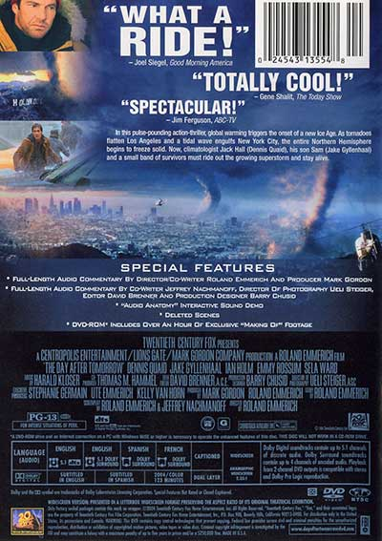
BACK OF A DVD COVER

Slide 7
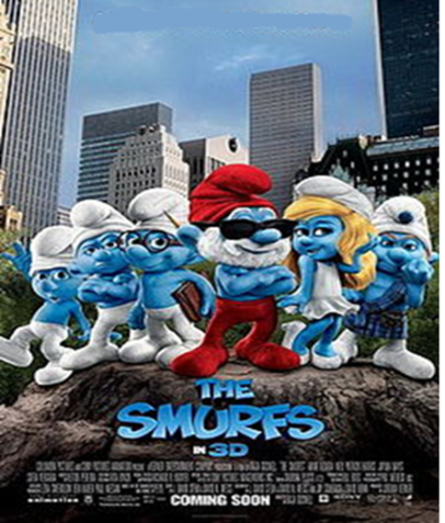
CINEMA FILM INFORMATION
Miniscule creatures called Smurfs live in a miniscule village where they work and have a joyful time. As the Smurfs get ready for the Blue Moon Festival, the evil Gargamel (an evil man who wants the Smurf`s power) attacks them which leads them to New York City.
As the Smurfs enter New York city, they discover the difficult realities and new relationships they must face with humans (Patrick and Grace), all the while running away from Gargamel that wants to take their blue magic away.
The smurfs will learn to deal with trying to get back home, adapting to the human world and once again trying to escape the hands of Gargamel.

Slide 8
BEFORE WRITING
BEFORE THE SUMMARY: READING THE TEXT 1) HIGHLIGHT THE TITLE + AUTHOR 2) HIGHLIGHT THE CHARACTERS
3) HIGHLIGHT THE TURNING POINT 4) WHAT IS THE SETTING AND MOOD ?
5) WHAT IS THE CONFLICT ?

Slide 9
WRITING THE SUMMARY
Paragraph 1: What is the Title + Author of the story? Who are the main characters ? What is the setting (time and place)? Paragraph 2: What is the problem? (turning point) What is the most intense part of the story ? (climax) What is the solution ? (resolution) Paragraph 3: What is the message of the story? OR What do the characters learn ?
125 – 150 words. 3 Paragraphs.

Slide 10
CATEGORY | 100 - 90 | 80 | 70 - 60 | 59 -
ELEMENTS INCLUDED | All of the elements (title, author, main characters) are included in summary. | Some of the elements (title, author, main characters) are missing in summary. | Most of the elements (title, author, main characters) are missing in summary. | None of the elements (title, author, main characters) are included in summary.
PLOT | Plot is explained at a complex level and is in order. | Plot is explained at a modest level and is in order. | Plot is somewhat explained or not in order. | Plot is explained at a minimal level and not in order.
CONFLICT | Conflict of the story is successfully mentioned. | Some of the conflict is missing. | The conflict is not in order or rarely included. | The conflict does not exist.
MESSAGE/ LESSON | Message is strong and lesson is successfully mentioned. | Message is present and/or so is the lesson. | Message/lesson is either weak and/or not present. | Message and/or conflict are very weak or not present.
SPELLING AND GRAMMAR | Contains few – some errors in grammar, punctuation and capitalization. | Contains many errors in grammar, punctuation and capitalization. Errors may interfere with reader's understanding. | Contains serious errors in grammar, punctuation and capitalization | The text is incomprehensible.

