Slide 1
SWEATSHOPS
- THE PROBLEM ☺ ONLINE GAME ☹ PRIMARK COLLAPSE

Slide 2
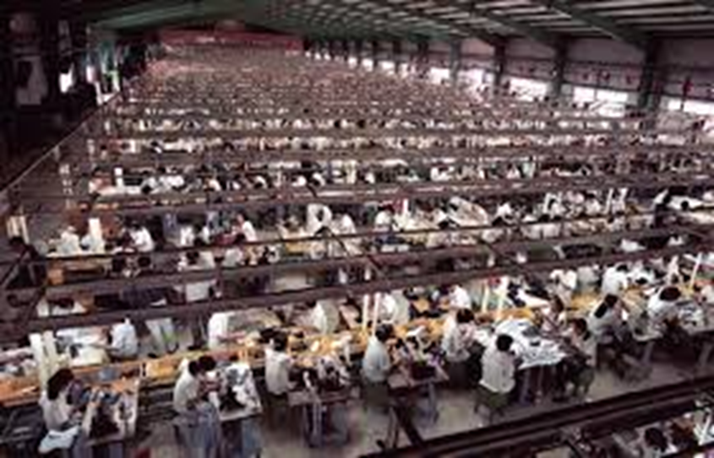
SWEATSHOP
a factory or workshop where workers are employed at very low wages for long hours and under poor conditions.

Slide 3
NEGATIVE (NIKE)
https://www.youtube.com/watch?v=wzq31hpGZOI

Slide 4
YOU HAVE BEEN HIRED AS A NEW SWEATSHOP WORKER !!!
http://www.simsweatshop.com/

Slide 5
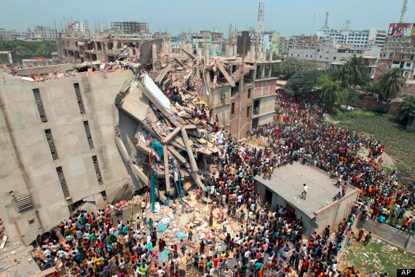
PRIMARK BUILDING
https://www.youtube.com/watch?v=JYBlSC6xBGo

Slide 6
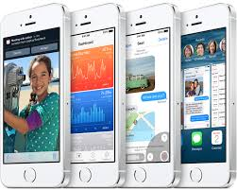
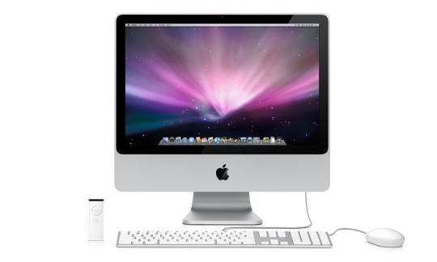
Who in this class has an Apple product ?
http://www.youtube.com/watch?v=unrZw5qZzws
DO YOU THINK APPLE USES SWEATSHOPS TO MAKE THEIR PRODUCTS ? WHY?

Slide 7
FIND ONE COMPANY THAT IS KNOWN FOR USING SWEATSHOPS
FIND A COMPANY.
WHAT DO THEY SELL ?
HAVE YOU EVER BOUGHT ITEMS FROM THAT COMPANY ?
I chose __________. They sell ___________. Yes I bought ___________ from that company. No, I did not buy anything from that company.

