Slide 1
THE BODY
EXAMPLE: IS FACEBOOK A POSITIVE THING FOR OUR SOCIETY?

Slide 2
STRUCTURE
FIRST TOPIC SENTENCE
FIRST EXPLANATION
FIRST CLOSING SENTENCE
SECOND TOPIC SENTENCE
SECOND EXPLANATION
SECOND CLOSING SENTENCE

Slide 3
1. TOPIC SENTENCE
INTRODUCES THE BODY PARAGRAPH
STATES WHAT YOU ARE GOING TO ARGUE. HERE IS AN EXAMPLE:
Firstly, Facebook is a positive thing for our society because it allows us to contact people who live far away.

Slide 4
2. EXPLANATION
EXPLORES AND GIVES AN EXAMPLE TO SUPPORT YOUR TOPIC SENTENCE.
IT ANSWERS THE QUESTION WHY AND HOW? HERE IS AN EXAMPLE:
If you have a cousin who lives in Italy, it will be too expensive to call or text them but with Facebook you can contact them and send pictures for free.

Slide 5
3. CLOSING SENTENCE
IT CLOSES THE BODY PARAGRAPH BY REPEATING IN DIFFERENT WORDS YOUR TOPIC SENTENCE.
HERE IS AN EXAMPLE:
Therefore, Facebook is very good for our society because it is an easy and free way to contact family members that live far away.

Slide 6
AS A WHOLE
Firstly, Facebook is a positive thing for our society because it allows us to contact people who live far away. If you have a cousin who lives in Italy, it will be too expensive to call or text them but with Facebook you can contact them and send pictures for free. Therefore, Facebook is very good for our society because it is an easy and free way to contact family members that live far away. Secondly, Facebook is a positive thing for our society because it allows us to access the news very rapidly. If something bad happens around the world and you are not close to a television or the radio, by looking at your Facebook account you can see what happens live. Therefore, Facebook is a great way to listen to the news.
130- 140 words

Slide 7
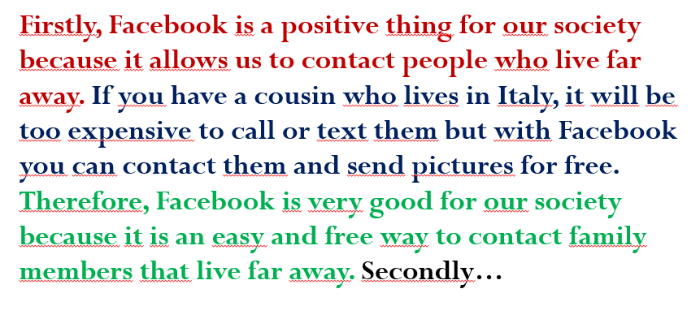
Your Turn
You will choose a thesis statement and write a body paragraph. 1) Physical education should be obligatory because it can help children stay fit and it helps students to destress. 2) Schools should ban the presence of cellphones because it distracts students from their school work and it can encourage cyber bullying at school. 3) Violence in sports should be abolished because players can experience long-term health consequences and it teaches children that violence is acceptable in any competitive activity.

