Slide 1
WAVE BY ERIC WALTERS

Slide 2
WARNING
THE CONTENT YOU ARE ABOUT TO READ ABOUT IS BASED ON A TRUE STORY. REAL PEOPLE HAVE BEEN AFFECTED BY THIS EVENT.
IT IS IMPORTANT TO LEARN AND READ ABOUT TRUE EVENTS SO WE CAN PROPERLY REACT AND UNDERSTAND WHAT PEOPLE HAVE EXPERIENCED.
BE WARNED THAT SOME CONTENT THAT WE WILL TALK ABOUT OR SEE IN CLASS MAY SEEM SHOCKING OR DISTURBING.

Slide 3
The Story…
It is December 2004 and Sam Brooks and his parents are flying from their home in New York to Phuket, Thailand, for their annual Christmas holiday at a small resort on the beach. For the first time, this year, his nineteen-year-old sister Beth won’t be coming along. She has to stay behind for a university swimming meet.
In the early hours of December 26th, Beth receives a phone call from her boyfriend, Tad, telling her to turn on the television. While Tad does his best to support her over the phone, Beth watches news reports of the devastation caused by a tsunami that has struck the coasts of Indonesia, Malaysia, and Thailand.

Slide 4
Two Point of Views
The story is told through two different characters:
Chapters 1 – 10 are told in Sam`s perspective Going to Thailand + Experiencing the disaster
Chapters 11 – 20 are told in Beth`s perspective Learning about the disaster + Going to Thailand to save her family

Slide 5
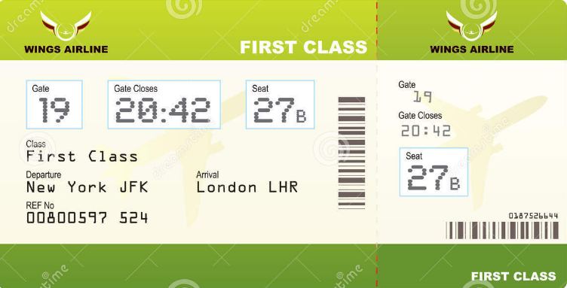
CHARACTERS
Main Characters: Sam & Beth (Brother and Sister)
Mom
Dad
Tad (Beth`s boyfriend)
Steve the pilot
Phuket, Thailand

Slide 6
From New York TO Phuket, Thailand

Slide 7
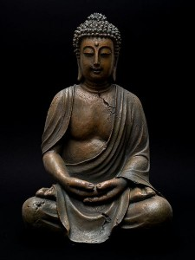
SETTING: THAILAND
TIME: DECEMBER 2014
PLACE: PHUKET, THAILAND

Slide 8
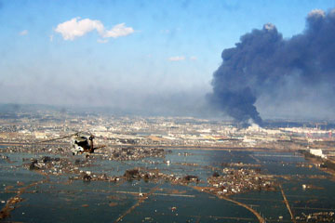
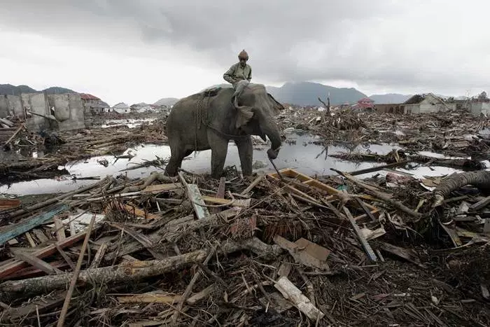
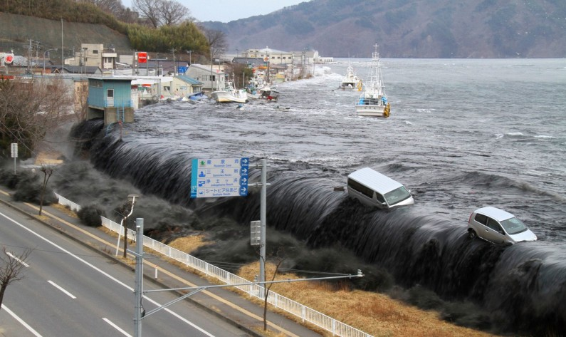
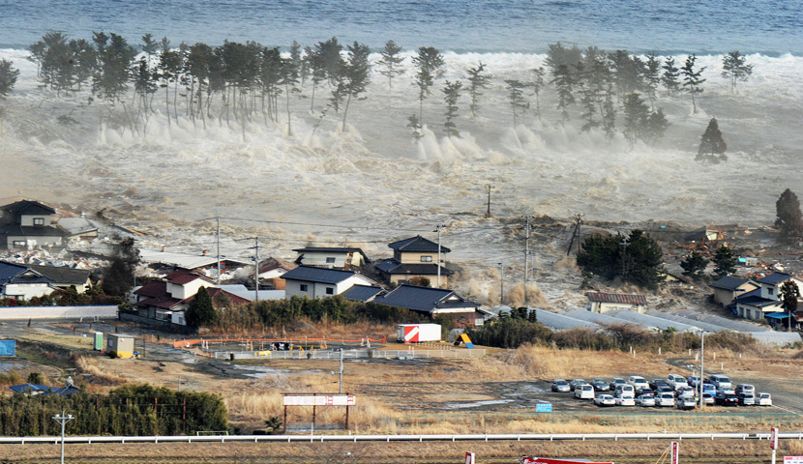
DISASTER: TSUNAMI 2004

Slide 9
EDPUZZLE: TSUNAMI THAILAND 2004
Before you read « Wave », you need to be informed of the major conflict of the novel: the 2004 tsunami disaster.
https://edpuzzle.com/media/58212490ae44125c086b920e

Slide 10
On a paper, answer the following questions:
1. What shocked you the most about this video?
2. How did you feel watching this video?
3. What would you do in this situation?

Slide 11
FOR HOMEWORK: READ CHP 1 and Answer Questions
Why does Beth have to stay in New York?
What holiday season is it?
Where is the family going for the holidays?
Describe Beth in two words.
What sickness does the mom have?

